Slide 1

June 29, 2019
Notes:
This is one of KNI’s three electron and ion microscopy presentations:
Scanning Electron Microscopy (SEM)
Dual Beam SEM & Gallium Focused Ion Beam Microscopy (Ga-FIB)
Helium & Neon Focused Ion Beam Microscopy (He,Ne-FIB)

Slide 2
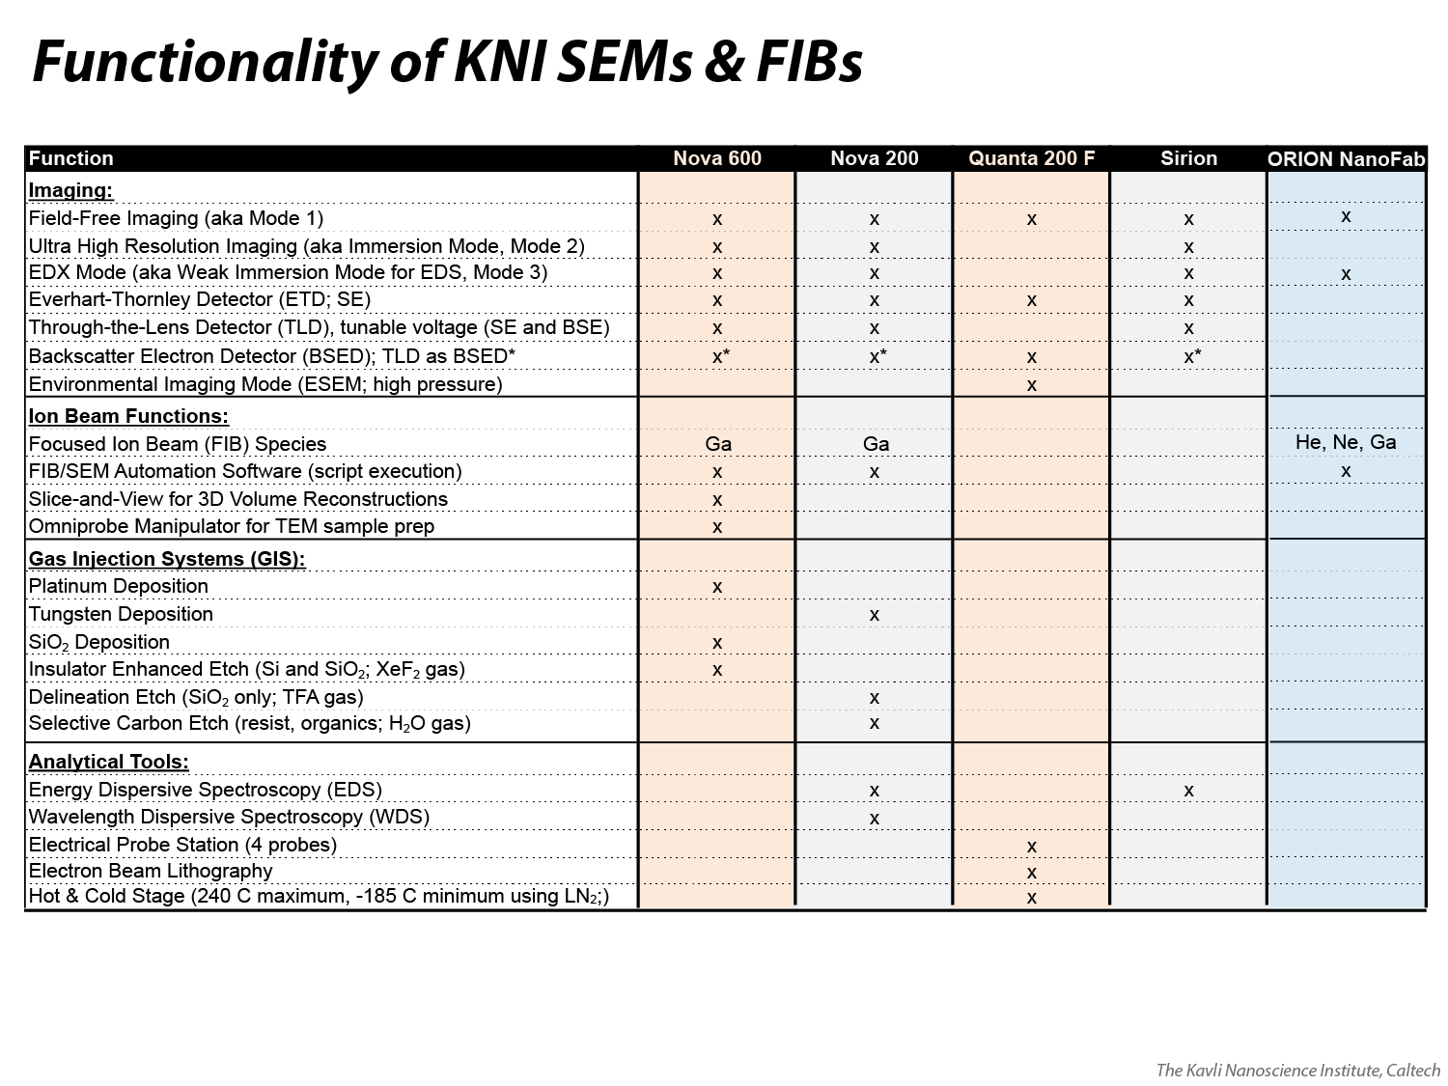
Notes:
An index of all scanning electron microscopy (SEM), focused ion beam (FIB) and related functionality on the four KNI SEMs, which are all products of the Thermo Fisher company. See separate KNI presentation for functionality and details related to the Zeiss ORION NanoFab He/Ne/Ga-FIB.

Slide 3

Notes:
Three different books that are recommended for learning more about SEM, Ga-FIB and Helium Ion Microscopy (HIM), respectively.

Slide 4
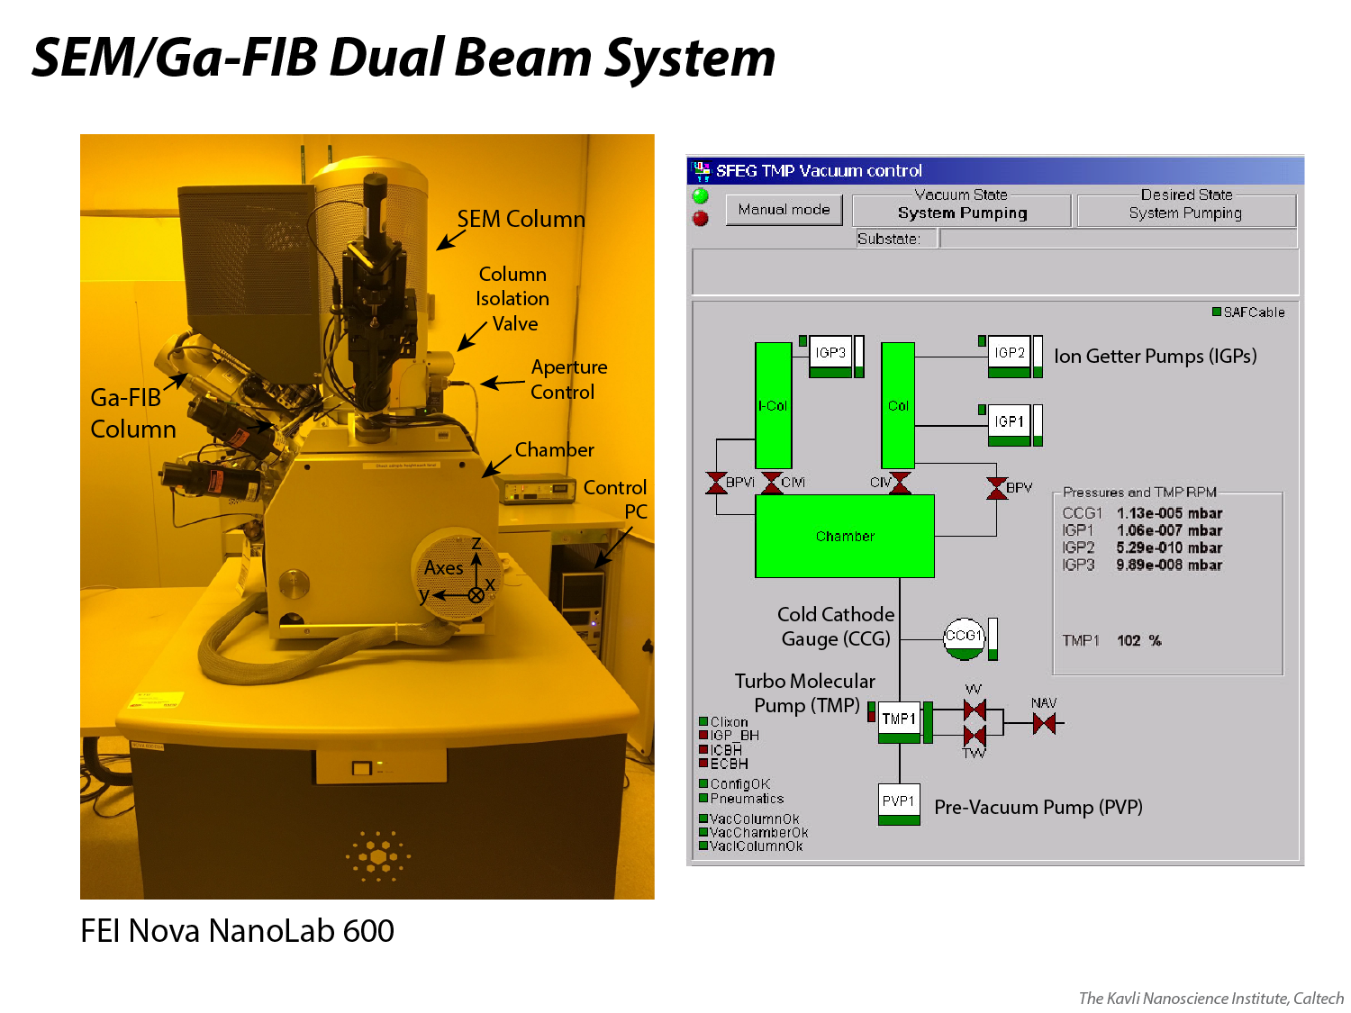
Notes:
The basic architecture of a dual beam system in which a scanning electron microscope (SEM) column is on the main, vertical, optical axis and the Ga-FIB (focused ion beam) column is offset by a 52 degree angle, pointing toward the chamber from the positive Y direction of the scan axes (tilting the stage to 52 degrees would bring a specimen surface perpendicular to the Ga beam); the X axis points into the page, i.e. toward the back wall in this image. An SEM column consists of an electron-beam-generating source at the top (see Slide 14), condenser and objective lenses (Slides 9-12), a column isolation valve, and a mechanism to change the aperture size, primarily. See a full schematic of the column optics on Slides 15-16.
An SEM-only design, as with the KNI’s Sirion and Quanta microscopes, omits the Ga-FIB column, but maintains the same basic architecture of the SEM column and chamber (along with their own attachments, detailed on Slide 2).
The overview of the vacuum system system can be seen at right. The chamber is pumped by a dry scroll pre-vacuum pump (PVP) and a turbo molecular pump (TMP); chamber pressure is read by a cold cathode ionization gauge (CCG) and typically ranges from high e-7 mbar to low e-5 mbar. The SEM column achieves progressively higher vacuum toward the top, with one ion getter pump (IGP) for the mid-column (low e-7 mbar) and another IGP for the upper column (high e-10 mbar), which contains the source. The FIB column has its own IGP to maintain vacuum in the low e-7 mbar range.

Slide 5
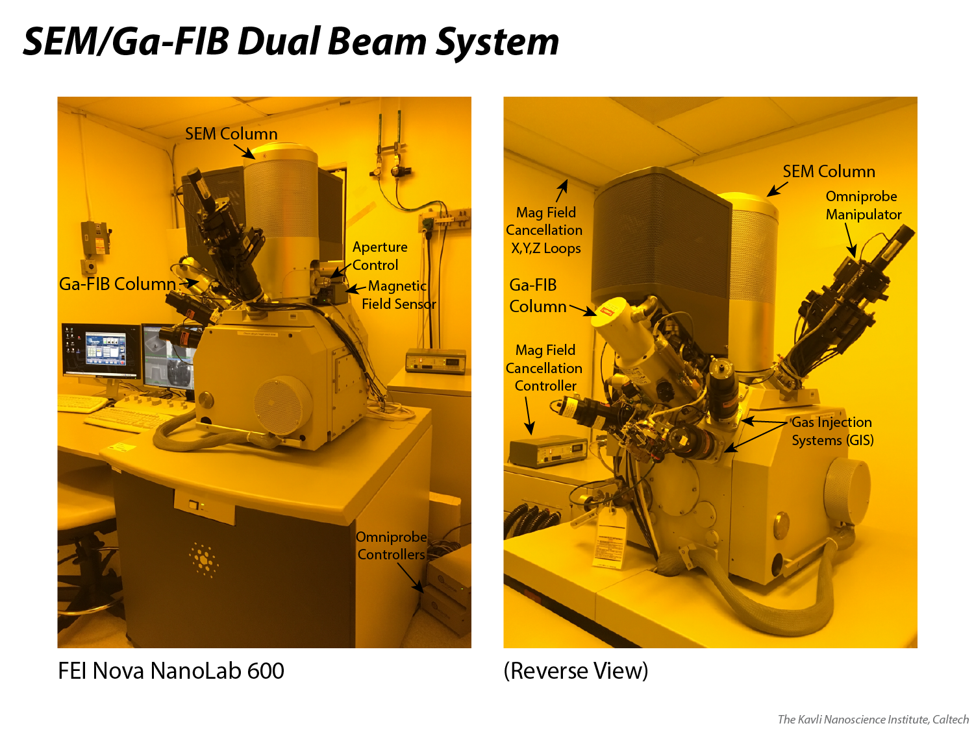
Notes:
A more detailed look at an SEM/Ga-FIB system, in this case the Thermo Fisher (formerly FEI) Nova NanoLab 600, shows some other, optional, auxiliary components. The Nova 600 and Quanta SEM each have a magnetic field cancellation system; a magnetic field sensor is placed next to the column and a controller runs an appropriate amount of current through X, Y and Z wire loops that are mounted on the room’s walls in order to cancel the X, Y and Z components of that field (this yields improved imaging when ambient magnetic fields are high in a room and would otherwise cause periodic beam deflections).
The Nova 600 and Nova 200 each have three gas injection systems (GIS), which dispense precursor gases that can result in material deposition or enhanced material etching, depending on the gas species. The Nova 600 also has an Omniprobe manipulator, a tungsten needle that can be used to push around material on – or extract material from – the specimen surface (it Is used primarily to extract samples that are prepared for TEM analysis). Other hardware not shown here include an EDS detector (Nova 200 and Sirion SEM) and WDS detector (Nova 200), and a probe station and hot/cold stage (Quanta).

Slide 6
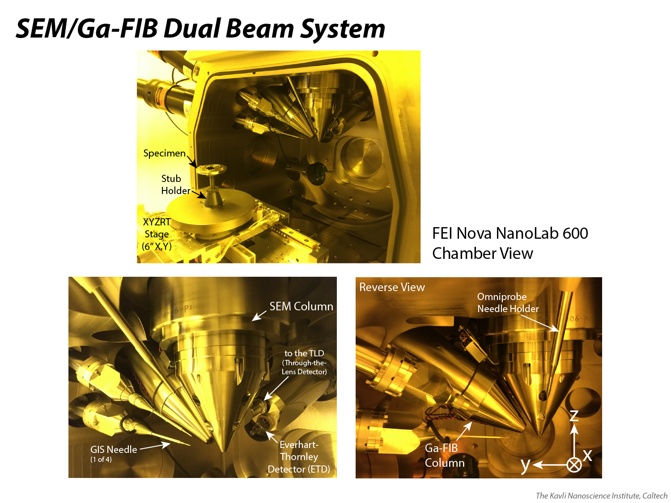
Notes:
A look inside the Nova 600 chamber, where an X/Y/Z/Rotation/Tilt stage can accommodate X/Y travel of +/- 76 mm (spans a full 6 inch wafer), ~12 mm of Z travel, 360 degree rotation, and tilt from -10 to +58 degrees. The yellow tint is a result of ultra-violet-radiation-blocking filters, which protect photo-sensitive materials (e.g. photoresists) that are used in the clean room.
The cone-shaped metal covers at the ends of both the SEM and Ga-FIB columns protect the objective lenses (Slides 10-12); in the SEM’s case, the outer and inner pole pieces that are a part of the ”field free” objective lens are concealed by the protective cover; holes bored into the protective cover allow the magnetic field of the “immersion lens” to leak out and engulf a sample when operating in that mode (Slide 12). Also shown here are the various detectors, gas injection system (GIS) needles, and the holder of the Omniprobe’s tungsten needle (the needle itself is nearly too narrow to see).

Slide 7
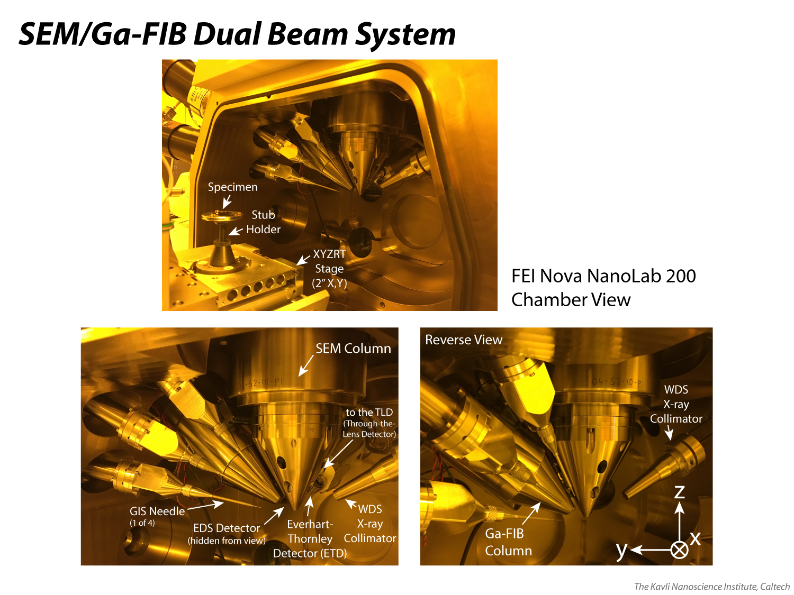
Notes:
A look inside the Nova 200 chamber, where an X/Y/Z/Rotation/Tilt stage can accommodate X/Y travel of +/- 25 mm (spans a full 2 inch wafer), ~25 mm of Z travel, 360 degree rotation, and tilt from -10 to +58 degrees. The yellow/orange tint is a result of ultra-violet-radiation-blocking filters, which protect photo-sensitive materials (e.g. photoresists) that are used in the clean room.
The cone-shaped metal covers at the ends of both the SEM and Ga-FIB columns protect the objective lenses (Slides 10-12); in the SEM’s case, the outer and inner pole pieces that are a part of the ”field free” objective lens are concealed by the protective cover; holes bored into the protective cover allow the magnetic field of the “immersion lens” to leak out and engulf a sample when operating in that mode (Slide 12). Also shown here are the various detectors, gas injection system (GIS) needles, and the x-ray collimator for the WDS detector (the detector itself is out of view).

Slide 8
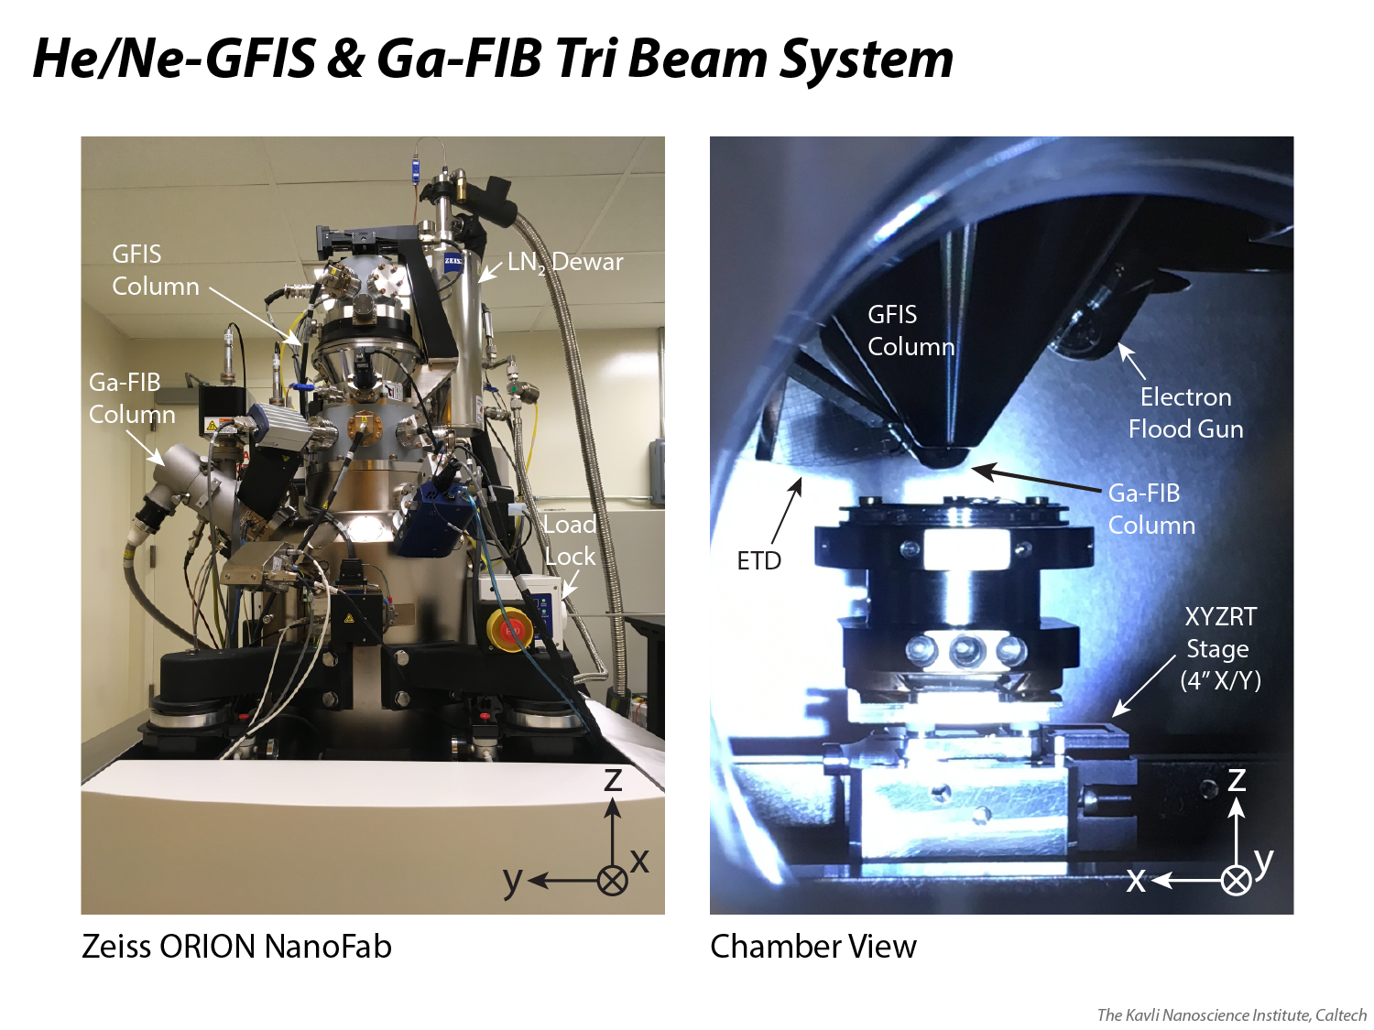
Notes:
The KNI also has a Ga-FIB column attached to the Zeiss ORION NanoFab, which is a three ion beam system. The other two ion beams are He+ and Ne+, each created via a gas field ion source (GFIS). The GFIS takes the place of the SEM in the standard “dual beam” architecture, where the GFIS column is on the main, vertical, optical axis and the Ga-FIB is offset by, in Zeiss’ design, 54 degrees. A separate KNI presentation has been put together for the ORION NanoFab system.

Slide 9
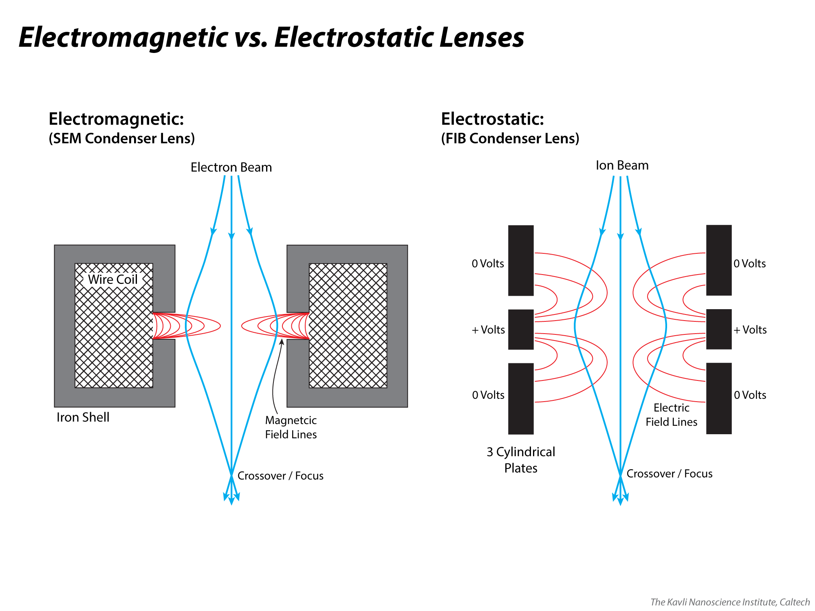
Notes:
Here we compare an electromagnetic condenser lens used on an electron microscope to an electrostatic condenser lens used on an ion microscope, both seen in cross-section (you should picture that these geometries extend 360 degrees around the optical axis).
An electromagnetic lens works by running current through a copper wire coil that is embedded in a donut-shaped, iron shell; the magnetic field is allowed to leak out from gaps that are machined into the inner diameter of the shell. The field is strongest close to the wire coil, allowing off-axis electrons to be bent back toward a crossover point; the field gets progressively weaker toward the center of the column, guiding progressively less-off-axis electrons toward the same crossover point.
An electrostatic lens works by grouping three parallel metal cylinders; the middle cylinder is held at positive potential relative to the outer cylinders, creating electric field lines as seen in the diagram. The field is strongest near the plates and weakest at the middle, allowing ions to be more strongly deflected the more off-axis they are. Ions may be directed to a crossover point (the terminology used for a condenser lens) or a focal point (the terminology used for an objective lens). A Ga-FIB typically does not fully cross over the beam with its condenser, while a GFIS-FIB does (see the column diagrams on Slides 15-16)
Electrostatic lenses must be used for ions because the ions are too massive to be deflected appropriately by the electromagnetic lenses of the type and strength used in conventional electron beam systems. Also note that unlike a magnetic field, which does not add energy to a charged particle passing through it, since an electric field *does* change the energy of a charged particle passing through it, the electrostatic Einzel lens is designed to symmetrically decelerate and accelerate the beam in two stages (hence the two sets of electric field lines), such that it emerges from the lens with the same energy that it had upon entering.

Slide 10
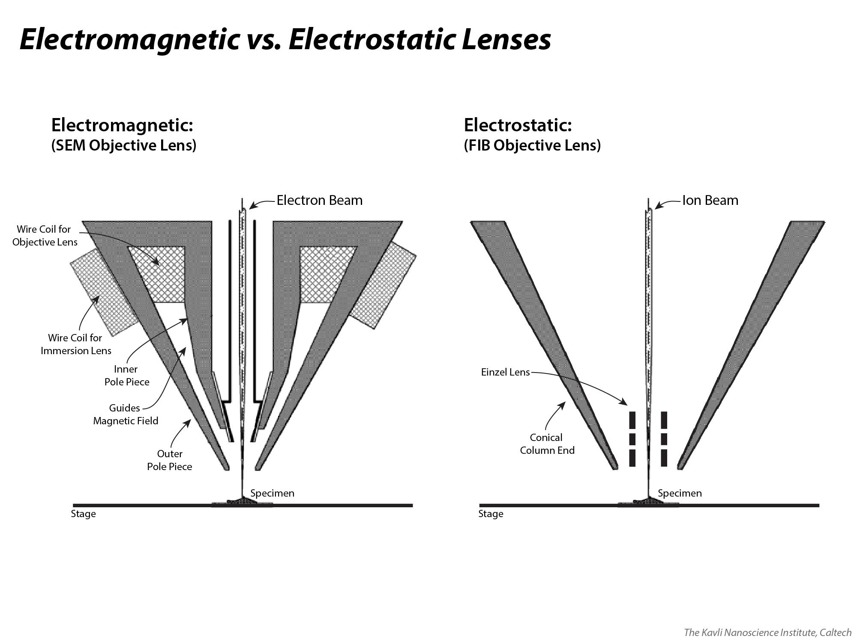
Notes:
The electromagnetic objective lens in a scanning electron microscope (SEM) is seen at left. The iron shell, often called a “pole piece,” now directs the magnetic field to leak out at the bottom of the column, where it directs electrons to come to a focal point at the specimen surface.
The objective lens for an ion microscope is the same configuration as the condenser lens for an ion microscope, i.e. an Einzel lens with three parallel cylindrical plates. An ion microscope’s objective lens is located at the base of the column, within the cone that protrudes into the chamber.

Slide 11
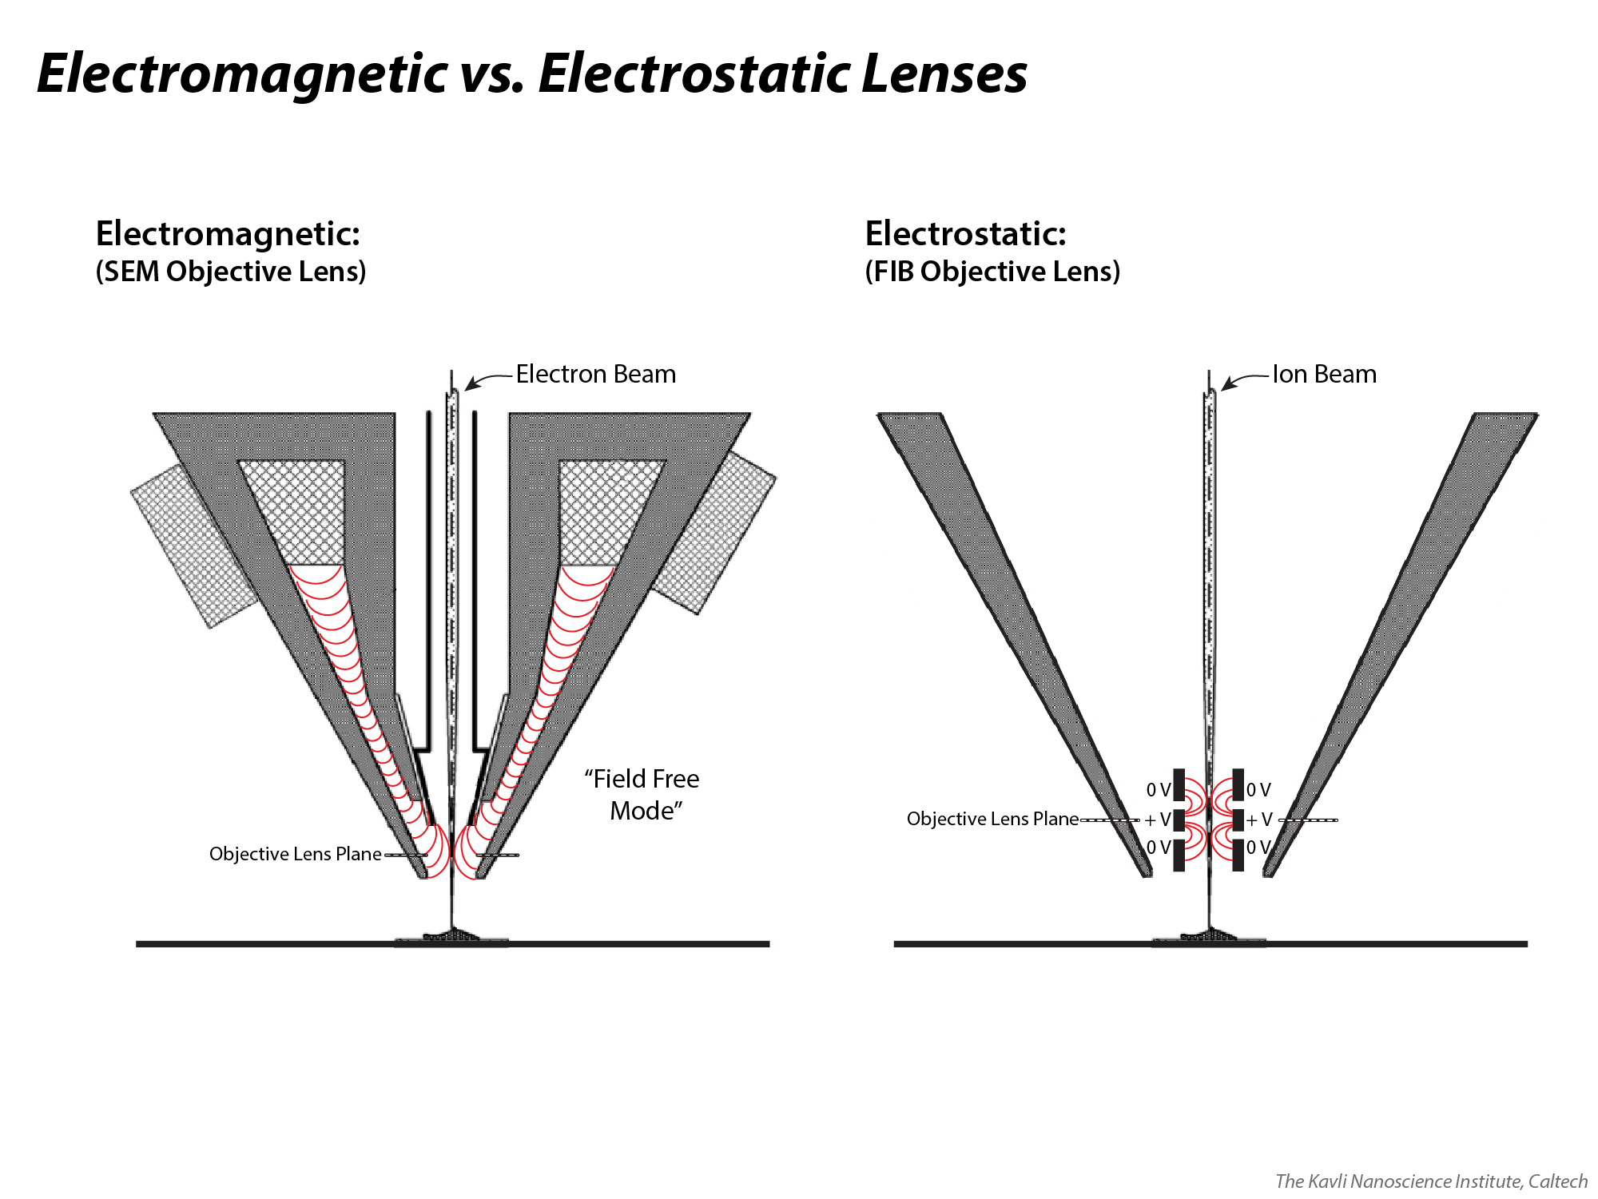
Notes:
The electromagnetic objective lens in a scanning electron microscope (SEM) is seen at left. The iron shell, often called a “pole piece,” now directs the magnetic field to leak out at the bottom of the column, where it directs electrons to come to a focal point at the specimen surface.
The objective lens for an ion microscope is the same configuration as the condenser lens for an ion microscope, i.e. an Einzel lens with three parallel cylindrical plates. An ion microscope’s objective lens is located at the base of the column, within the cone that protrudes into the chamber.

Slide 12
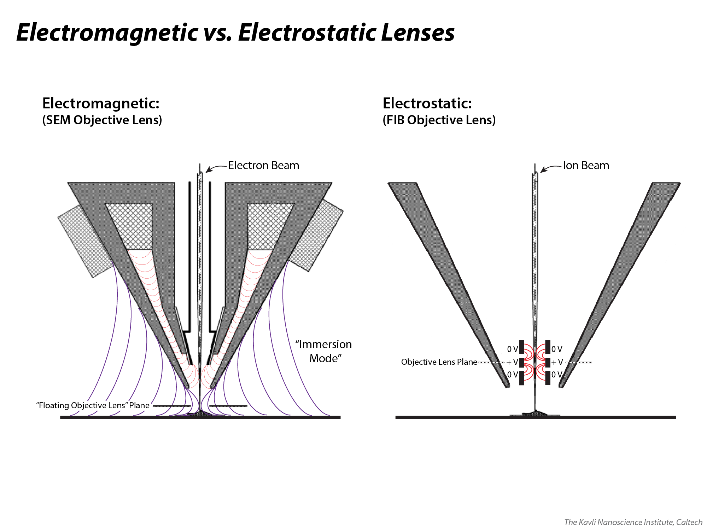
Notes:
SEMs often have a second electromagnetic objective lens, sometimes referred to as an “immersion lens,” which is used for highest resolution imaging. A second (concealed) wire coil on the outside of the objective lens’ iron shell creates a magnetic field that immerses both the column and the sample. The magnetic field lines converge roughly as seen in the image, creating a “floating lens” between the bottom of the column and the sample. This lens yields an effectively shorter working distance (i.e. the distance between the lens and the sample is now smaller), allowing for a steeper convergence angle that produces a smaller probe size for higher resolution (the magnetic field also efficiently funnels secondary electrons back up into the column where a detector, e.g. a “through-the-lens” detector, TLD, captures them). The traditional objective lens may be kept On in a weak state during this “immersion mode” to assist the final focusing that is done by the immersion lens.
There is no equivalent “high resolution mode” for a Ga-FIB; there is only one objective lens mode, which utilizes the standard Einzel lens. The smallest Ga-FIB probe size achievable on KNI systems is ~7 nm (the most modern Ga-FIBs claim 5 nm or less). A Ne-FIB can achieve a ~2 nm probe size and a He-FIB can achieve a ~0.35 nm probe size.
Note that a helium ion microscope can leverage a basic electrostatic Einzel lens for resolution equal-to or greater-than that of an SEM’s immersion lens. It does not need an immersion lens to effectively reduce the working distance for smallest probe size and highest resolution because: (1) a single atom source does not require multiple condenser lenses to demagnify the beam; fewer lenses introduce fewer aberrations, generally, (2) He+ ions have a smaller de Broglie wavelength than electrons, which results in less degradation of probe size due to diffraction around column apertures (and allows for smaller apertures to be used, blocking out high-angle, divergent ions that are most subject to a lens’ spherical aberrations), and (3) the energy spread from the source is less for a He+ beam, resulting in less chromatic aberration. All of these factors allow for a long working distance (8+ mm) to be used in He imaging, which allows for great depth of field – far better than an SEM’s immersion lens – in addition to excellent resolution.

Slide 13
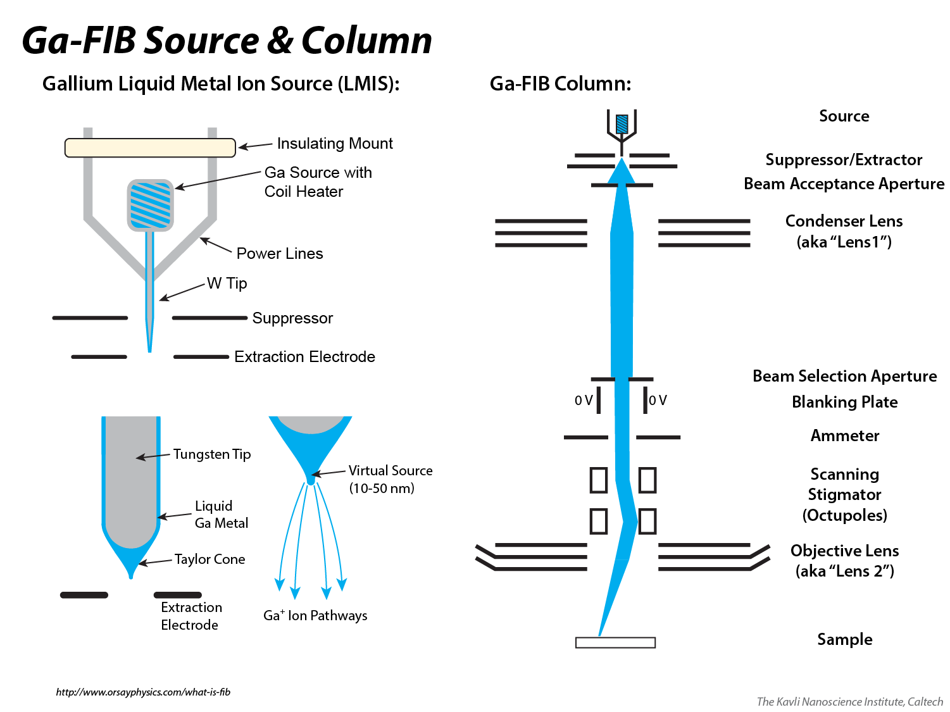
Notes:
Here the Ga-FIB’s liquid metal ion source (LMIS) and column optics, discussed in detail on slides 14 and 15, respectively, are shown side-by-side in a larger form, to summarize the source and column on one slide.

Slide 14
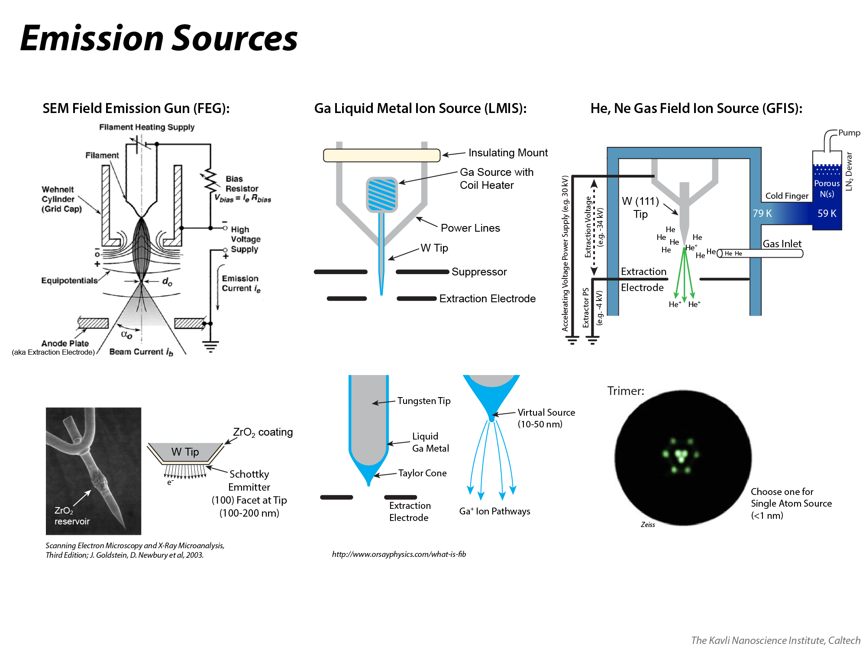
Notes:
Diagrams of the sources for a field emission gun (FEG) SEM, a Ga-FIB liquid metal ion source (LMIS), and a He/Ne gas field ion source (GFIS). The reader should recognize a number of similarities that exist in their respective design.
In a FEG-SEM (KNI SEMs are all of the Schottky Emitter variety), current runs through a hairpin filament with a single-crystal tungsten tip attached to it (as shown in the picture, bottom-left), heating it to approximately 1800 C. The tungsten tip has a facet on the end, which is designed to be the (100) facet of a single crystal. Electrons are thermionically emitted from the facet. A negative potential is also applied to the tip, resulting in a strong electric field at the tip end, which lowers the work function to allow more electrons to be emitted. A thin coating of ZrO2 lowers the work function of the tip, which allows for more emission than otherwise could be realized, and yields a bright source; the ZrO2 slowly evaporates over the lifetime of the tip (typically 12-36 months) and is replaced by equally slow diffusion of ZrO2 from a reservoir on the tip. The virtual source of a Schottky FEG is 20-30 nm, which requires demagnifying by a condenser lens (or two) to create a probe size on the order of single nanometers, necessary to achieve the FEG-SEM’s high resolution limit of 2 nm or less, depending on the settings and construction of the SEM.
In a Ga-LMIS, a solid Ga reservoir is held at the base of a tungsten tip, inside a wire coil. In order to produce Ga+ emission, the coil is heated, which melts the Ga above 30 C. Liquid Ga wets the tungsten tip, which has a relatively blunt end with radius of curvature on the order of 100s of nm or greater. A suppressor-and-extractor electrode combination forms the liquid Ga into a Taylor Cone geometry, which has a virtual source of 10-50 nm (depending on the settings and which research/company claims you believe). The smallest probe size (typically defined as the diameter containing 50% of the probe current) that is achievable with a Ga-LMIS is about 5-7 nm at 1 pA. Increasing probe currents (up to 10s of nA) can yield probe sizes on the order of 100s of nm.
A GFIS works by holding a cryogenically cooled, atomically sharp W tip at a positive potential and bleeding He or Ne gas into the gun area to create a pressure in the e-6 Torr range (without gas, the gun area is held in the e-10 Torr range). When gas atoms go near the positively-biased tip, they are polarized and drawn to within nanometers of the tip end, where the electric field – created by the potential difference between the tip and an extractor electrode – is most highly concentrated. At this range, an electron tunnels from the gas atom to the tip, creating a He+ (or Ne+) ion, which is subsequently drawn away from the tip by the electric field. Many such ionization events happen per unit time and the resulting stream of ions – a “beamlet” – is accelerated down the GFIS column and ultimately focused into a sub-nm probe by a series of electrostatic lenses. The “trimer” refers to three atoms at the end of the tip that stabilize each other, electrically and mechanically, as this ionization process takes place; each of the three atoms forms a beamlet; weaker beamlets may emerge from other tip atoms that are perched at the edges of facets, like the six spots that surround the trimer atoms in the schematic image shown. The fact that a He (or Ne) beam emerges from a single atom source is one of the keys to achieving a sub-nm final probe size (as small as 0.35 nm). A separate KNI presentation describes the operation principles of a GFIS in more detail.

Slide 15
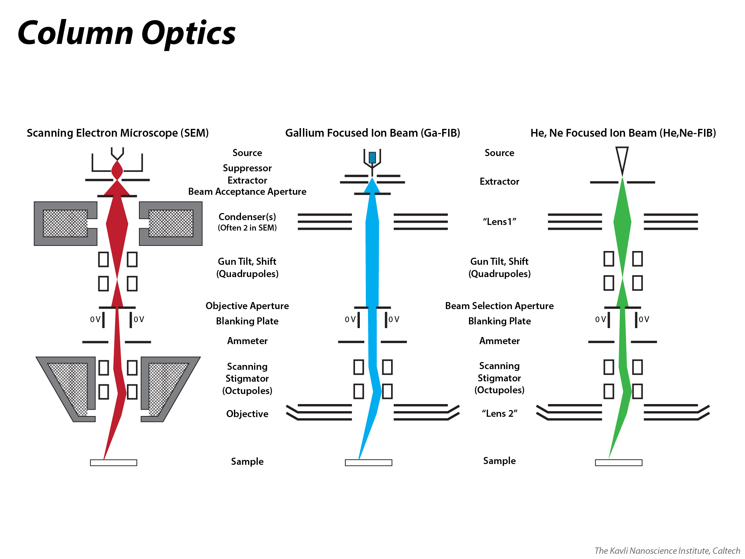
Notes:
Labelling of the column optical components for an SEM (left), Ga-FIB (middle) and He/Ne-GFIS (right). The columns are rather similar. While the sources and extractor/suppressor electrodes are all different (details on Slide 14), the basic column architecture is the same whether using electromagnetic (SEM) or electrostatic (Ga-FIB and He/Ne-GFIS) lenses. Note that the condenser and objective lenses are referred to as “Lens 1” and “Lens 2”, respectively, in the ORION NanoFab GFIS vernacular.
All utilize an aperture to limit the amount of the beam that passes through to the objective lens (“objective aperture” for electrons, “beam selection aperture” for ions). And just before the beam enters the objective lens, all utilize electrostatic octupoles to deflect the beam (for scanning) and to shape the beam into a circular cross-section (correct astigmatism for smallest probe and best resolution). One difference is in the upper column after the condenser lens: SEM and GFIS columns utilize electrostatic quadrupoles to shift and/or tilt the beam, ensuring it is well-aligned along the main optical axis (and, consequently, well-aligned to the aperture and objective lens). Some companies (e.g. Tescan) utilize a single quadrupole to steer the Ga beam after the condenser lens in some models, but this is not the case for the Ga-FIBs in KNI’s Zeiss and FEI instruments.
Note that in SEMs, there are often two condenser lenses (schematically represented here as one “ganged” condenser), which help to demagnify the beam from a broad virtual source (10s of nanometers) to its final probe size (single nanometers); a two-condenser-lens system also allows more control of the numerical aperture and the crossover position. In SEM and GFIS, crossing over the beam closer to the aperture allows more current to pass through, while conversely, crossing over higher in the column yields a larger spread of charged particles at the aperture and therefore less current passing through. The Ga-FIB condenser does not cross the beam over before passing it through the beam selection aperture, making it a simpler design with simpler beam steering at the top of the column, compared to SEM and GFIS, where beam shifting and tilting are common user alignments.

Slide 16
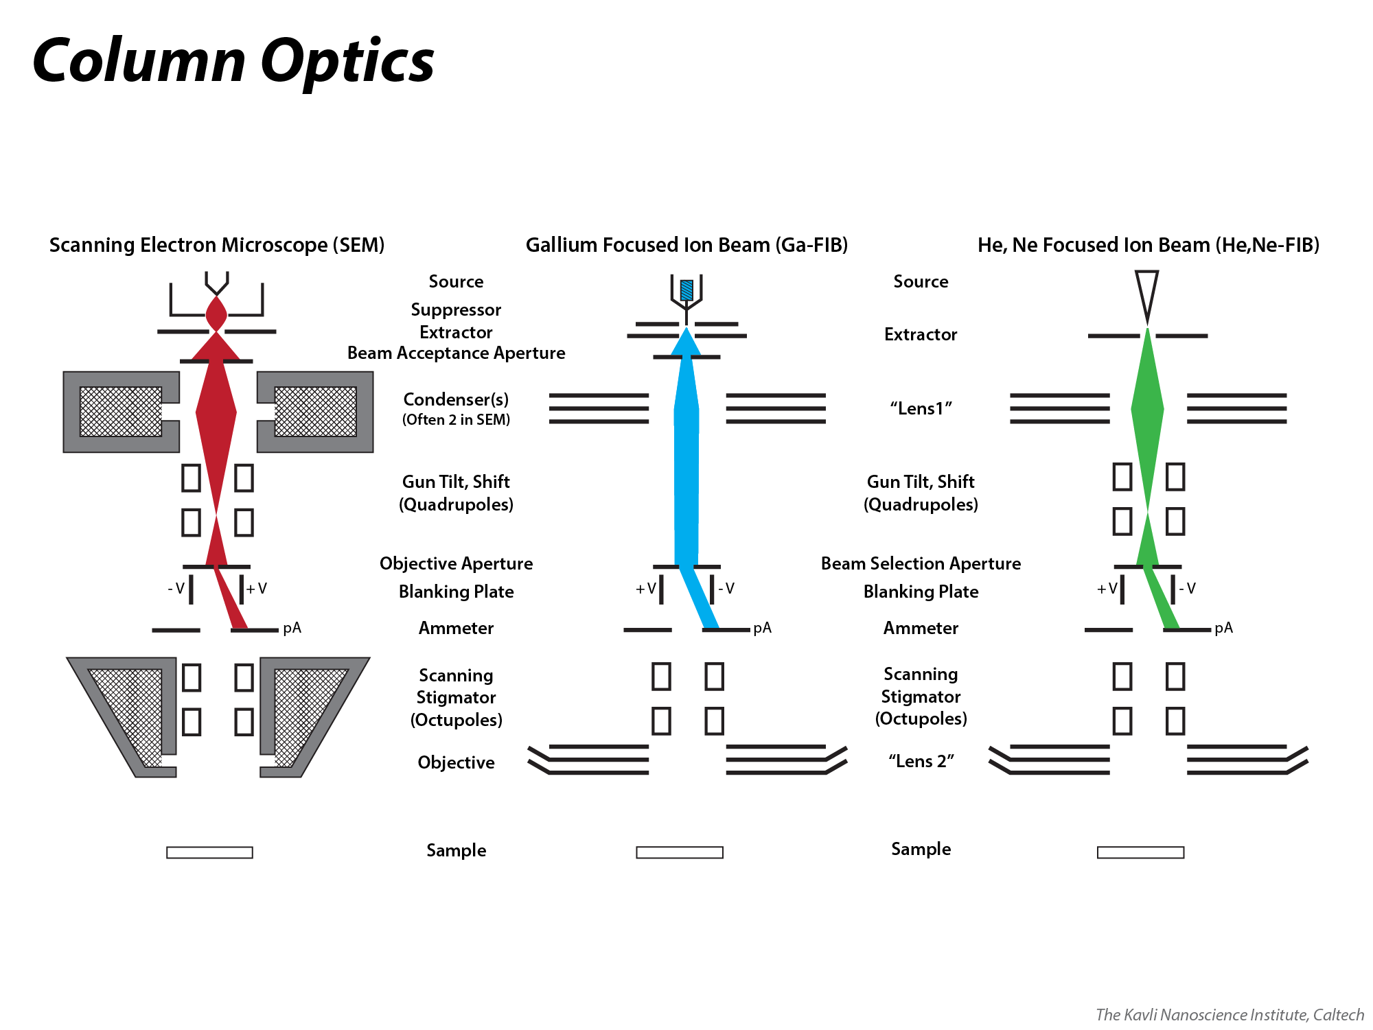
Notes:
Here, the same columns are shown with their beams “blanked” by an electrostatic beam blanker. In modern systems, the blanking is done directly into an ammeter so that the beam current can be measured any time it is not actively scanning across a specimen (in older systems, current measurements are made through the stage, which means that the values are lower than the actual current since some current is lost as signal… unless the beam is dropped into a Faraday cup on the specimen holder, in which case all current is measured without losing any signal). In the KNI, all SEMs measure current through the stage and all FIBs measure current through an ammeter that is built into the FIB column.
Electrostatic beam blankers are important for all microscopes because they allow for the beam to only scan the surface when intended. For milling applications in ion beam systems, it is crucial that the beam does not make contact with the sample when not undergoing a milling operation because otherwise the beam would be sputtering the sample when idle. Similarly, for lithography applications in electron beam systems, when e-beam writing is not in process, it is important to blank the beam so that the resist material is not unintentionally exposed.

Slide 17
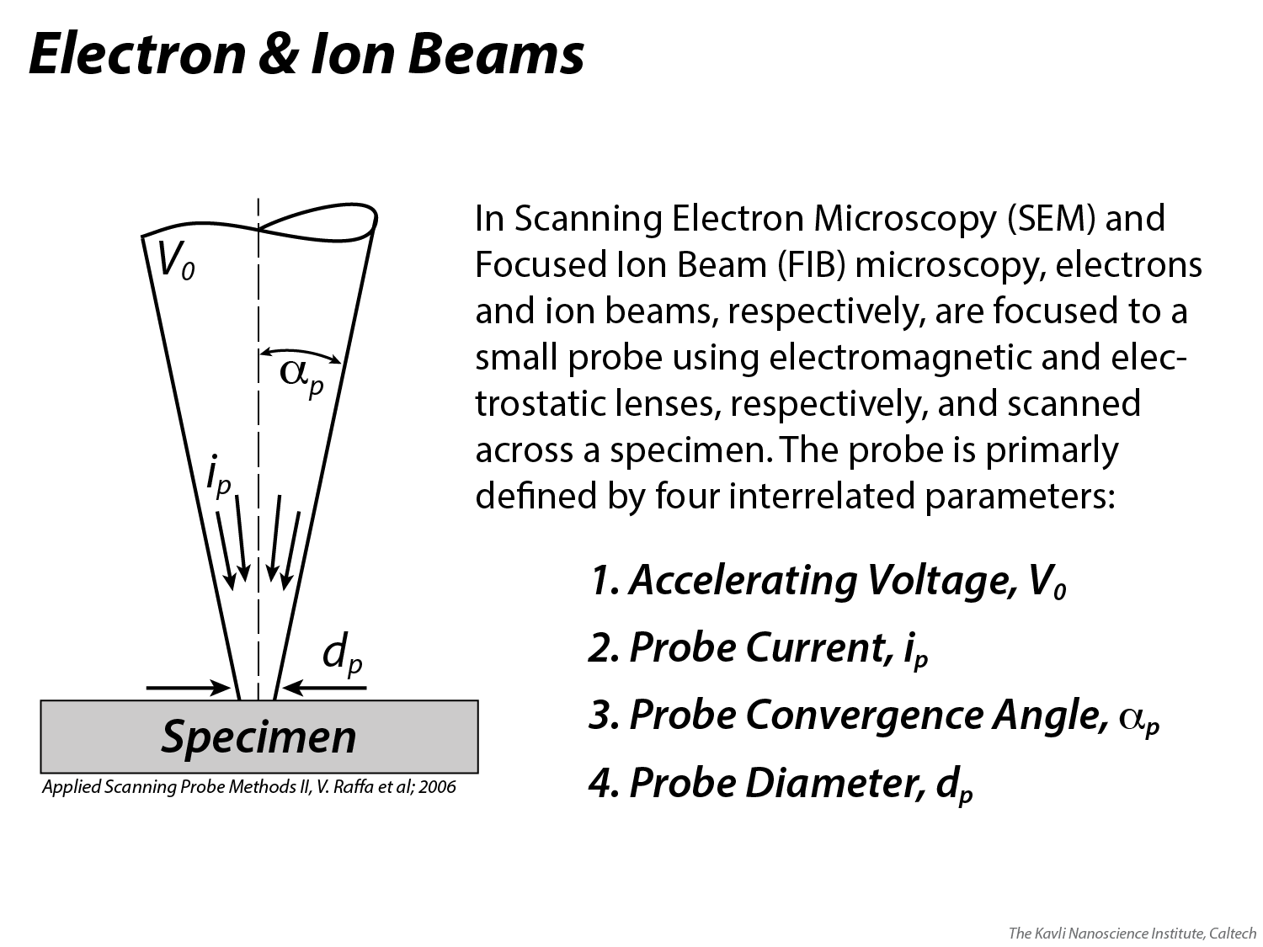
Notes:
Electron and ion beams can generally be described by the four parameters outlined on this slide.

Slide 18
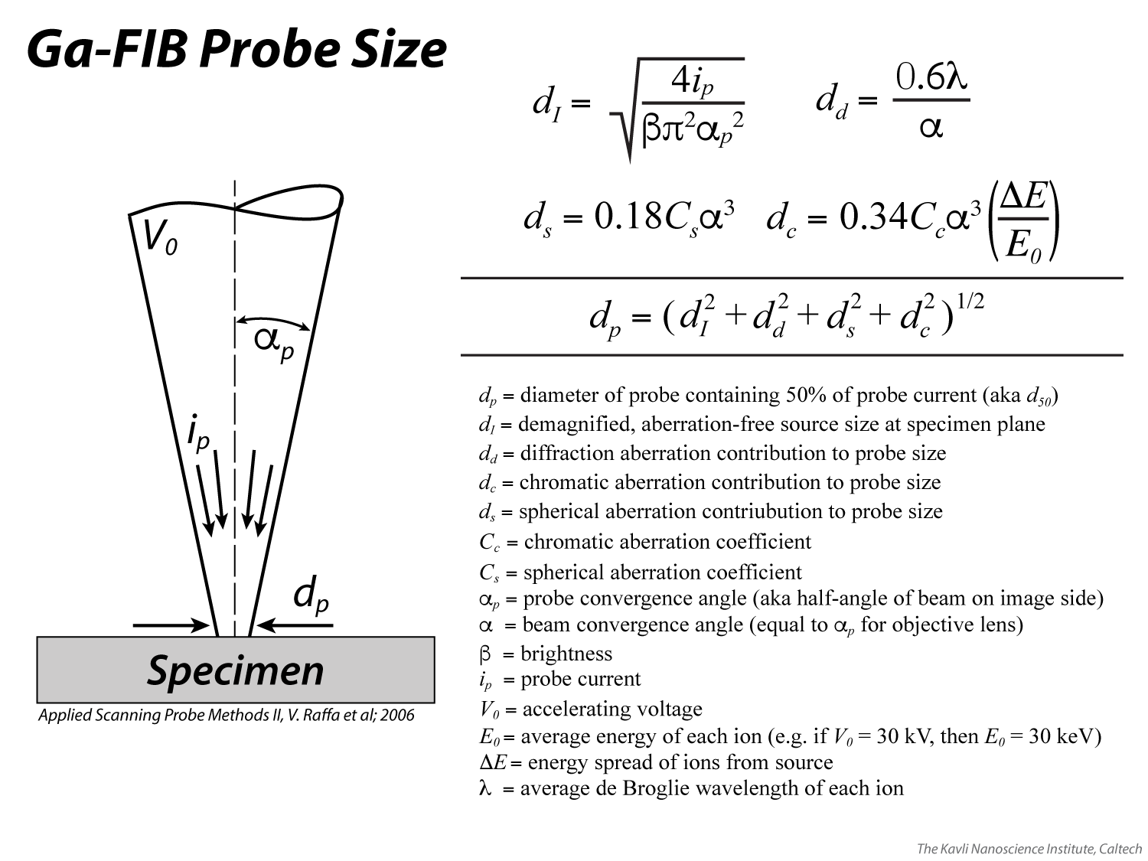
Notes:
An overview of the relevant equations in Ga-FIB optics. Many factors contribute to the final probe diameter, which determines the final 2D resolution of the image. It is not entirely necessary that users work with these equations when doing ion microscopy. However, it is good to have a general understanding of the underlying physical concepts and equations, and how they interrelate.

Slide 19
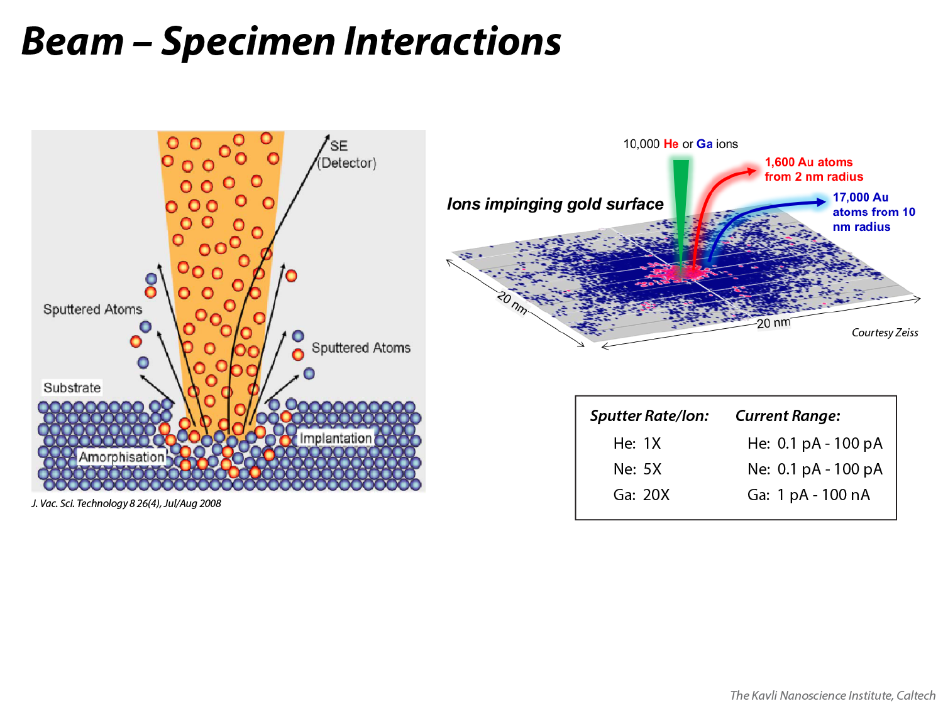
Notes:
At left, a basic diagram of any ion species interacting with a specimen, showing the ejection of sputtered atoms and secondary electrons, along with implantation that can cause local amorphization of the substrate’s crystallinity. Even when operating at higher currents for milling purposes, only a few angstroms of material are typically sputtered on any given pass of the beam.
At right, a simulation of 10,000 He+ and Ga+ ions impinging a gold surface. While the ion sputter rate of He is a full order of magnitude less than that of Ga, making for far slower milling times, the He sputter radius is also an order of magnitude smaller, resulting in the production of smaller milled features.
A general rule of thumb is that per incident ion, if He sputters at a rate of 1x, Ne sputters at ~5x, and Ga at ~20x (ratios will vary by the material and kV). When you also consider that He and Ne beams can be generated with a range of current that is orders of magnitude less than Ga, you see a compounding effect – Ga can sputter many orders of magnitude more volume that He and Ne. On reasonable time scales (i.e. ranging into hours of beam time), while Ga can be used to sputter 10s to 100s of um^3 of material, Ne should be thought useful at sputtering 1s of um^3 of material, and He should be reserved for jobs where less than 1 um^3 needs to be removed. These estimates can of course be revised up or down depending on the hardness of the material and how long one is willing to operate a milling procedure. One should also keep in mind that the three beams can be used in a complementary fashion on the ORION NanoFab, perhaps switching from one to another on the same device, removing large volumes of material with Ga or Ne before switching over to perform the final removal of smaller amounts of material with Ne or He.

Slide 20
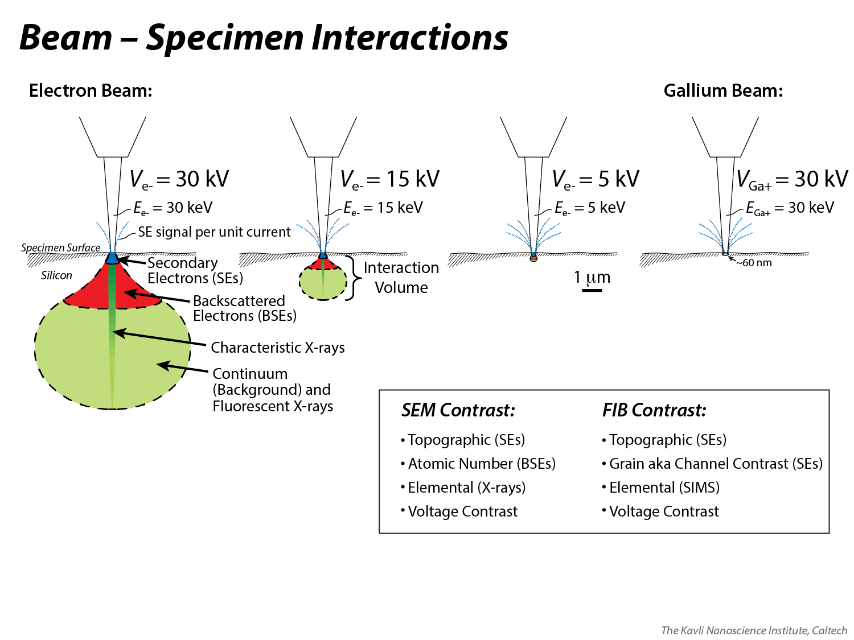
Notes:
A comparison of “interaction volumes” created by the interaction of an electron beam (left) and a Ga+ ion beam (right) with a specimen (in this case, all interactions were modeled with silicon as the specimen). The Ga+ ion beam at 30 kV accelerating voltage (30 keV energy per ion) penetrates as deeply as 60 nm into silicon, compared to 8000 nm for 30 keV electrons, 2500 nm for 15 keV electrons, and 400 nm for 5 keV electrons.
Whereas an electron beam interaction volume may be broken up into (1) secondary electrons (SEs) emitting from the top several nanometers for topographic contrast, (2) higher energy backscattered electrons (BSEs) emitting from the top ~30% of the volume for atomic number contrast, and (3) characteristic x-rays emitting from a narrow spike that extends from the surface to the bottom of the interaction volume for elemental contrast, a Ga+ ion beam interaction volume is classified almost entirely by SEs (there are not enough backscattered ions or x-rays created by ion bombardment to make the SEM’s standard BSE and x-ray detectors useful with a Ga-FIB. Only the top few nanometers of the Ga+ ion interaction volume is colored blue to represent SE emission because the SEs are low enough in energy (< 50 eV) such that only those generated near the top of the volume have enough energy to escape for detection.
An ion beam is not without its alternatives to topographic contrast, however. Depending on the orientation of a grain’s closest-packed atomic planes to the beam, ions may either penetrate deeply (close-packed is parallel to beam direction) causing fewer SEs to be generated at the surface and therefore darker pixels, or not deeply (close-packed is perpendicular to beam direction) causing more SEs to be generated at the surface and therefore brighter pixels; this kind of contrast based on the orientation of grains is often called “channel contrast” because the different openness of “channels,” as a function of atomic plane orientation, yields different amounts of SEs.
There is some atomic number (Z) contrast in an SE image generated by Ga+ ions because SE yield does increase, to a small degree, as a function of Z.
Secondary Ion Mass Spectroscopy (SIMS) can be used with ion microscopy as an alternative to SEM x-ray detection (via energy dispersive spectroscopy, EDS, or wavelength dispersive spectroscopy, WDS). In SIMS, which is more appropriate for Ne or Ga beams because they have much higher sputter yields than He, sputtered atoms are pulled into a detector and their energies, a function of their masses, are calculated and correlated to different elements. A SIMS system is not currently available with any KNI FIBs.
Finally, “voltage contrast” is observable in both electron and ion microscopy. In SEM, when a sample builds up negative charge due to presence of a non-conductive material, SEs are repelled away in higher abundance, yielding brighter pixels the more non-conductive a material is. In ion microscopy, a non-conductive specimen may build up a local positive charge from the incident ions and some of the resulting SEs will be drawn back down to the material to neutralize that charge, rather than being drawn to the SE detector; this results in darker pixels the more non-conductive a material is.

Slide 21
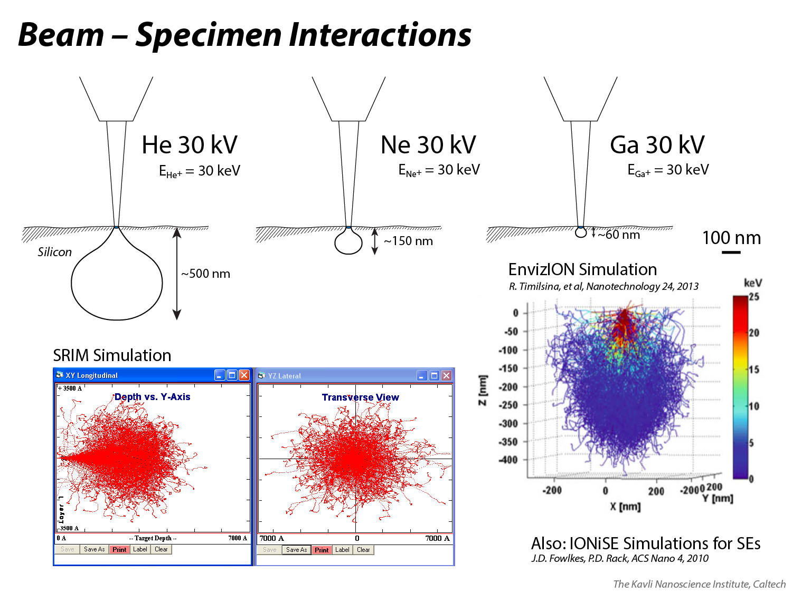
Notes:
Here, the interaction volume of a 30 keV Ga+ beam is compared to 30 keV He+ and Ne+ beams, which are also available in the KNI on a Zeiss ORION NanoFab He/Ne/Ga-FIB system. More massive species are stopped more readily by a substrate, which explains why the Ga interaction volume is smaller than that of Ne, which is smaller than that of He. All simulations were done with the software, SRIM (Stopping and Range of Ions in Matter), which is available for free download online.
Besides SRIM, there are other ion beam simulation programs that have been developed and described in the literature, e.g. EnvizION and IONiSE. EnvizION has the ability to simulate an evolving surface under FIB irradiation, and may be released in 2018 or 2019 as a publicly available software package. IONiSE specializes in simulating the SE yield of a material under irradiation of a FIB; its source code and executable files are available via the literature.

Slide 22
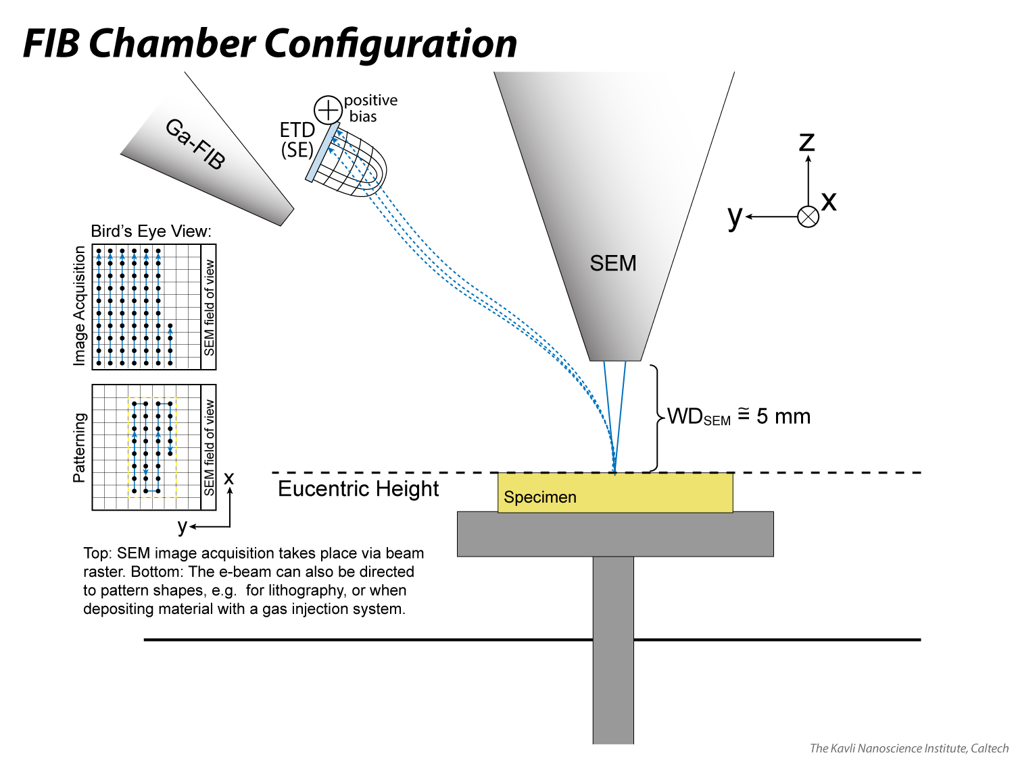
Notes:
At eucentric height (~4.8 mm WD from e-beam perspective on the Nova 200, ~5.1 mm on the Nova 600), the specimen can be tilted to any angle and the site of interest will stay centered in the SEM window. When moving to eucentric height, make sure that you do not have anything taller than your site of interest on your stub, e.g. a set screw that fastens a copper clip, which would threaten to contact the SEM pole piece at high tilt; if you have something tall like that on your stub, make sure that it is at a low position in the chamber when tilting (i.e. the tall feature should be at a positive Y position or far off to a positive or negative X position, never in line with the negative Y axis).

Slide 23
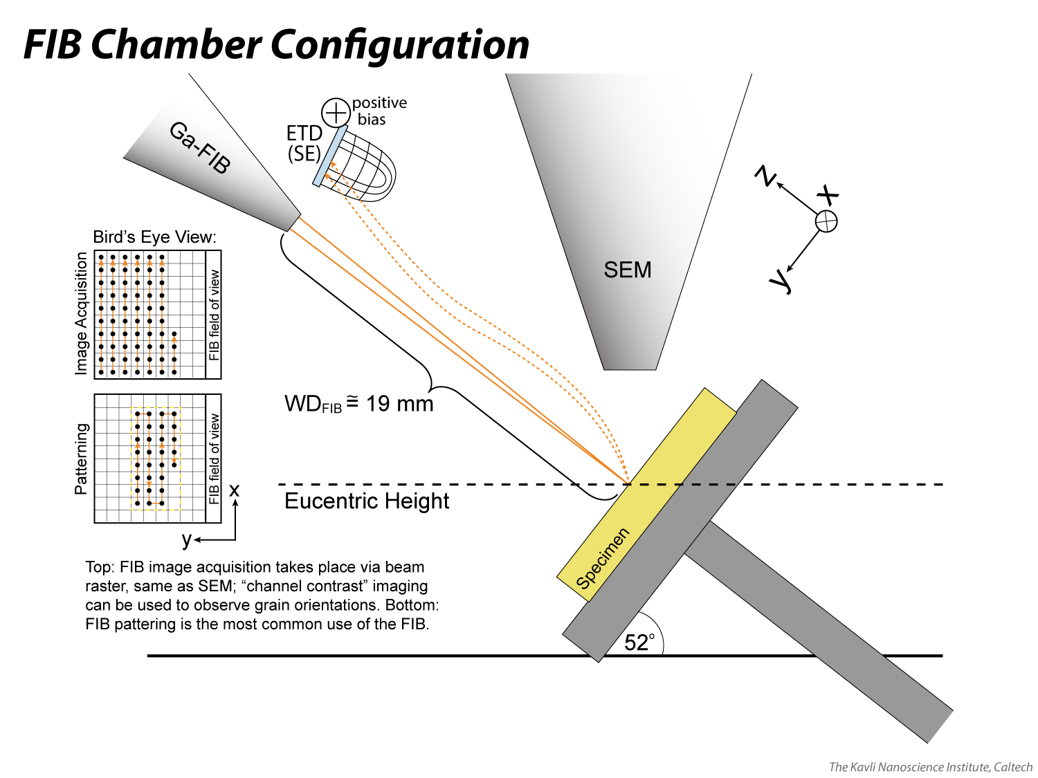
Notes:
Eucentric height corresponds to ~19 mm WD from the ion beam perspective. The ion beam sputters material, and in doing so also creates secondary electrons (SEs) that can be used to form a topographically contrasted image of the specimen surface. Again, make sure that you do not have anything taller than your site of interest on your stub, e.g. a set screw that fastens a copper clip, which would threaten to contact the SEM pole piece at high tilt; if you have something tall like that on your stub, make sure that it is at a low position in the chamber when tilting (i.e. the tall feature should be at a positive Y position or far off to a positive or negative X position, never in line with the negative Y axis).

Slide 24
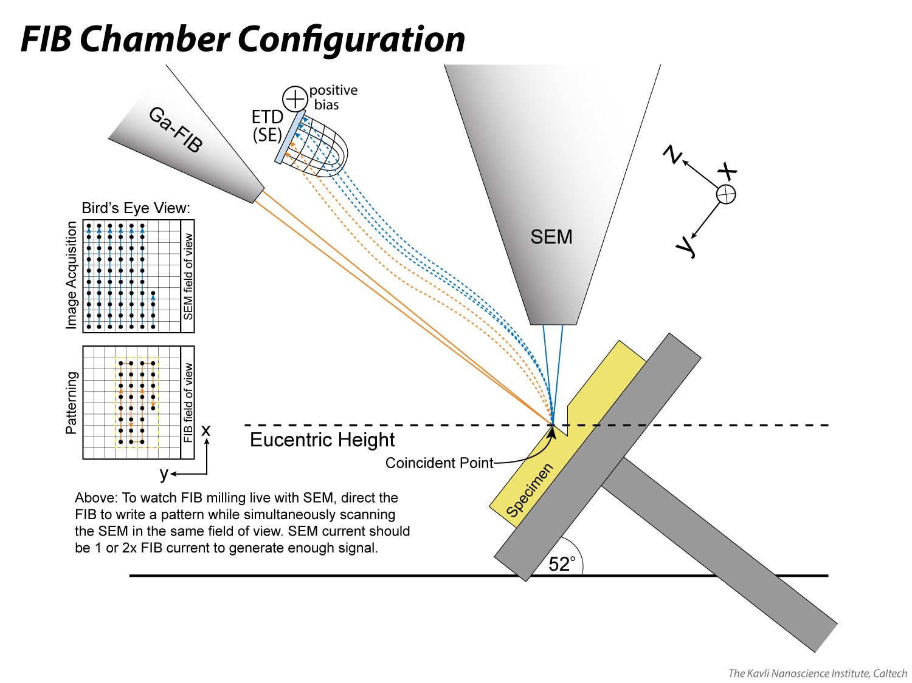
Notes:
A coincident point between the two beams is achieved at eucentric height, allowing the operator to observe the site of interest with either beam, or to pattern with the ion beam while simultaneously imaging with the electron beam. In order to generate a suitable e-beam image while the i-beam is patterning, the e-beam current must be sufficiently high to generate enough SE signal to overwhelm the SE signal coming from the i-beam (which is simultaneously contacting the specimen at a different location). Selecting an e-beam current that is at least equal to the i-beam current, if not two or more times greater, can produce this effect.

Slide 25
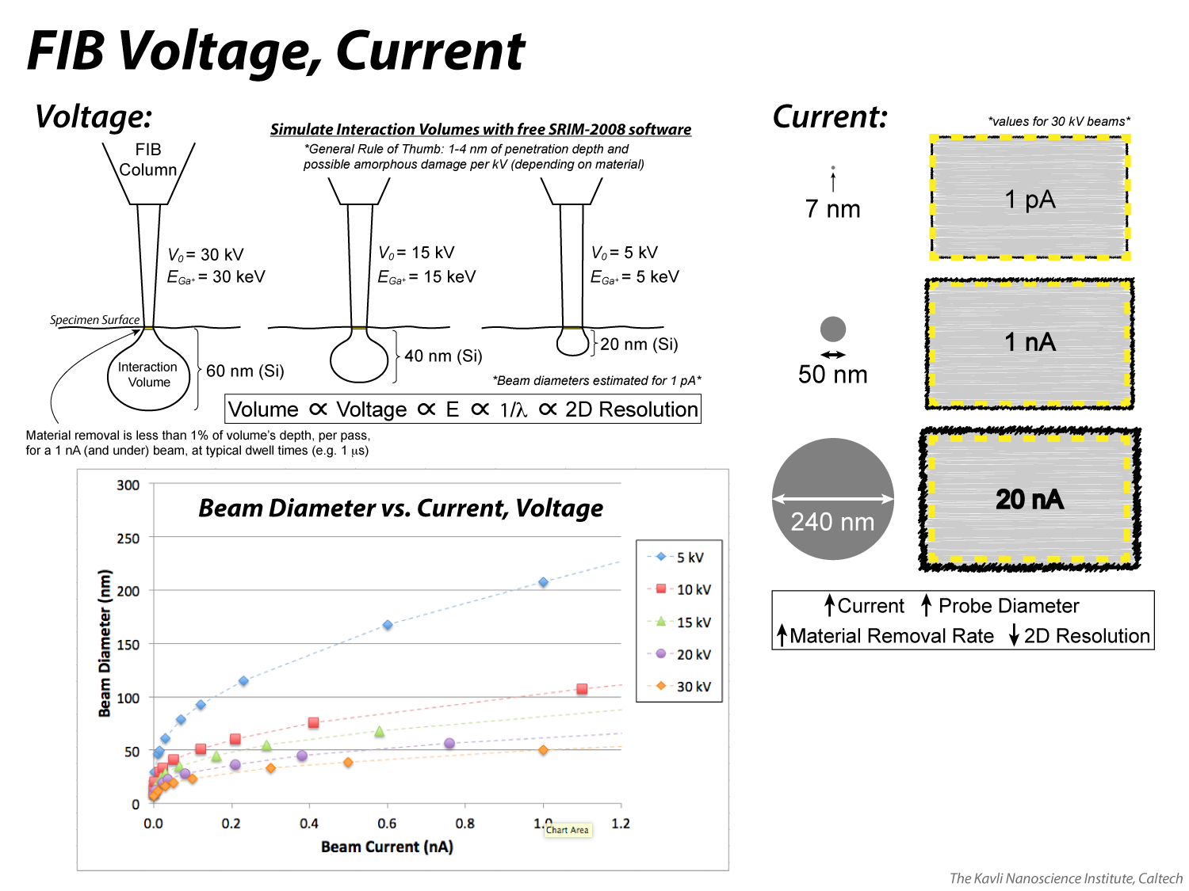
Notes:
As with the e-beam, the voltage of the i-beam controls the depth of penetration. In this case, that penetration depth defines a volume that becomes implanted with Ga. It is useful to model the interaction (e.g. with SRIM-2008 software, available for free online at http://www.srim.org/SRIM/SRIMLEGL.htm) to understand the 3D “damage zone” (e.g. possible loss of crystallinity, creation of ~amorphous zone) and how that might affect the material properties of your specimen/device. Running simulations and pairing them with practical milling parameters (e.g. 1 nA or lower current, 1 microsecond dwell), one can determine that less than 1% of the interaction volume depth is physically removed via sputtering per pass (aka per “loop”), so when you are done with your patterning, expect the damage zone to surround the full perimeter of your pattern, at a depth proportional to the voltage.
The current determines the probe diameter, which can be as small as 7 nm (30 kV, 1 pA), assuming perfect alignment. The probe diameter determines the 2D resolution, while the voltage determines the 3D resolution (i.e. with respect to the damage zone). Increasing current increases the probe diameter and the material removal rate; it also makes for a less well-defined pattern. At very low current, less SE signal will be emitted from the specimen, so the operator may need to go to lengths to maximize signal-to-noise in order to get sufficient visual feedback to perform a high-quality alignment. Using a reduced window at long dwell time, integrating one frame at a time and utilizing the alignment rectangle to make direct comparisons is one such technique (there is a video tutorial of this on the KNI YouTube page: https://youtu.be/XNgYe8ZDJvo).
Beam diameters decrease as a function of increasing voltage, as shown in the plot, the data for which is obtained from the user interface (Patterning page → Advanced Tab → Theoretical Beam Diameter).

Slide 26
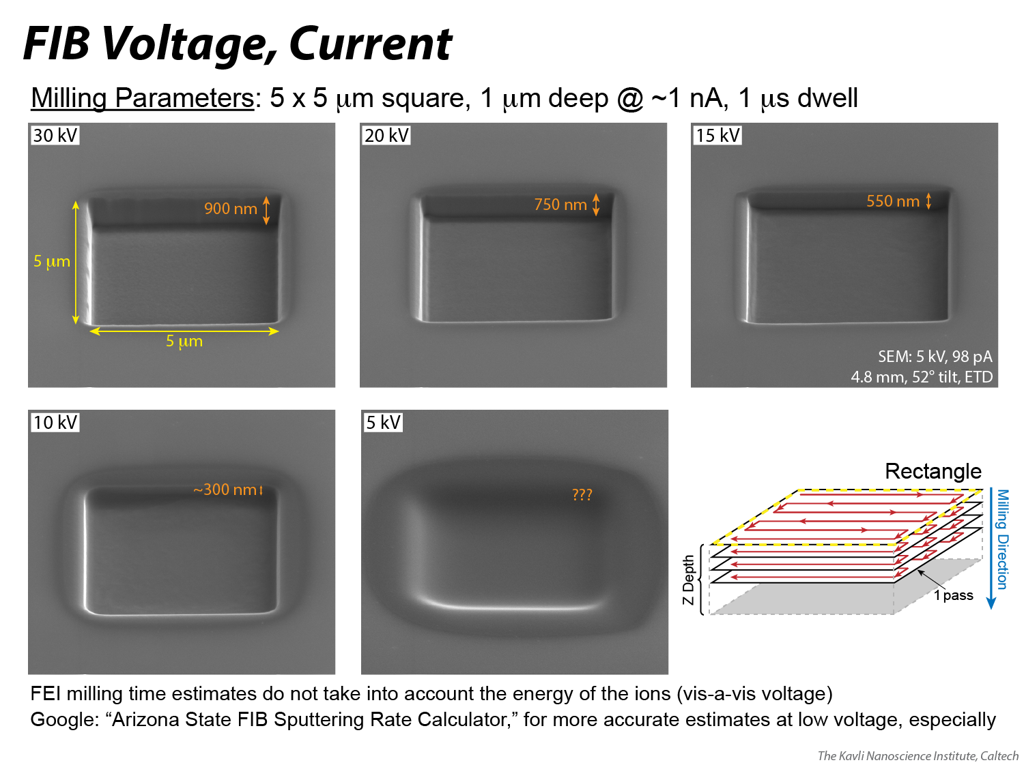
Notes:
A simple test, in which the same pattern is milled at different voltages, reveals that Thermo Fisher (formerly FEI) underestimates the time it expects low voltage beams to mill a pattern because it does not factor in the energy of the ions to the sputtering rate. Use Arizona State University’s sputtering rate calculator (http://www.asu.edu/clas/csss/NUE/FIBSputterCalcYamamura.html#Yamamura) to make better estimates. It is worth noting that at 30 kV, where the majority of patterning takes place in the KNI, the time estimate is reasonably accurate. The operator should take care to calibrate milling depth vs. time for his/her specimen material(s).
This slide also highlights that the milling resolution decreases as a function of decreasing voltage; the pattern edges are less and less well-defined at lower voltage.

Slide 27
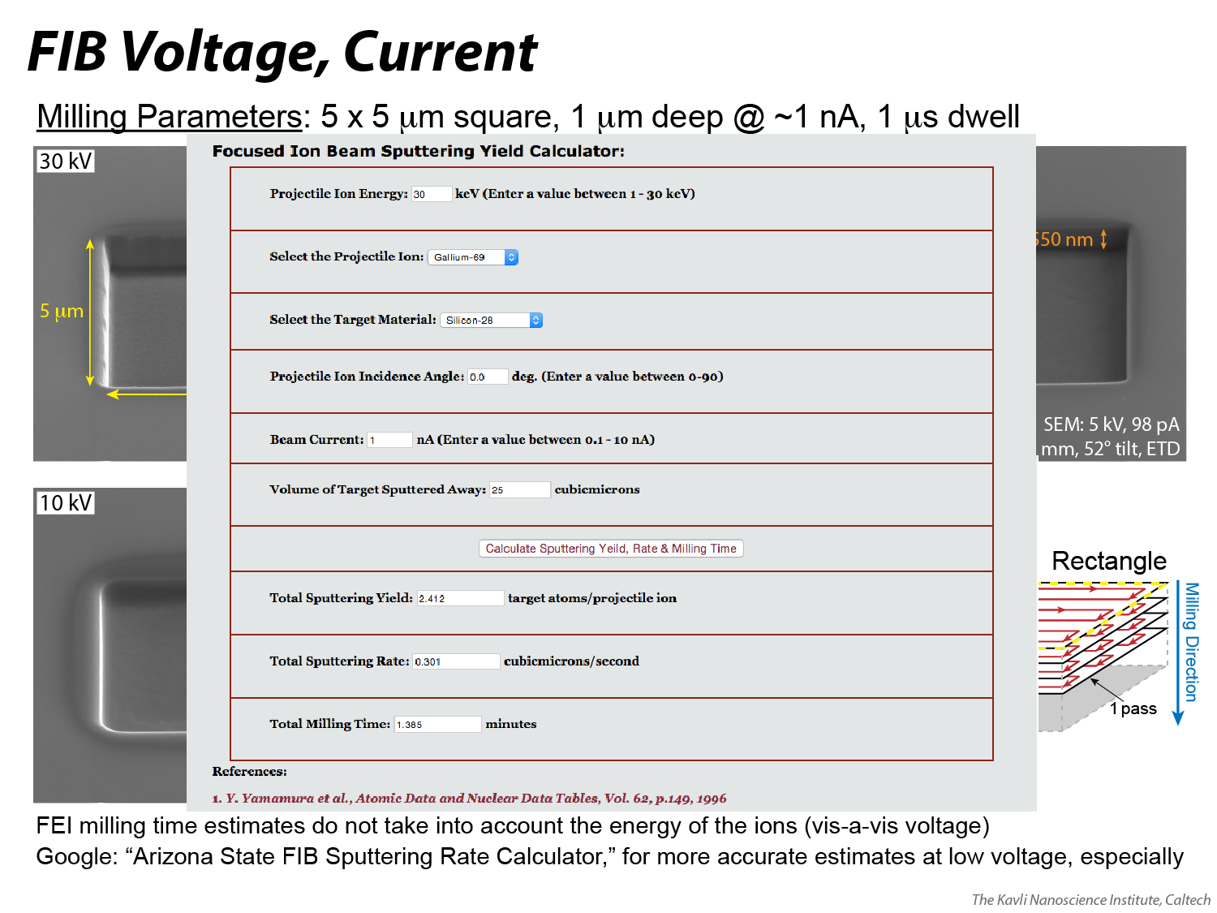
Notes:
An example of using Arizona State University’s sputtering rate calculator (http://www.asu.edu/clas/csss/NUE/FIBSputterCalcYamamura.html#Yamamura) to determine sputtering yield, rate and milling time.

Slide 28
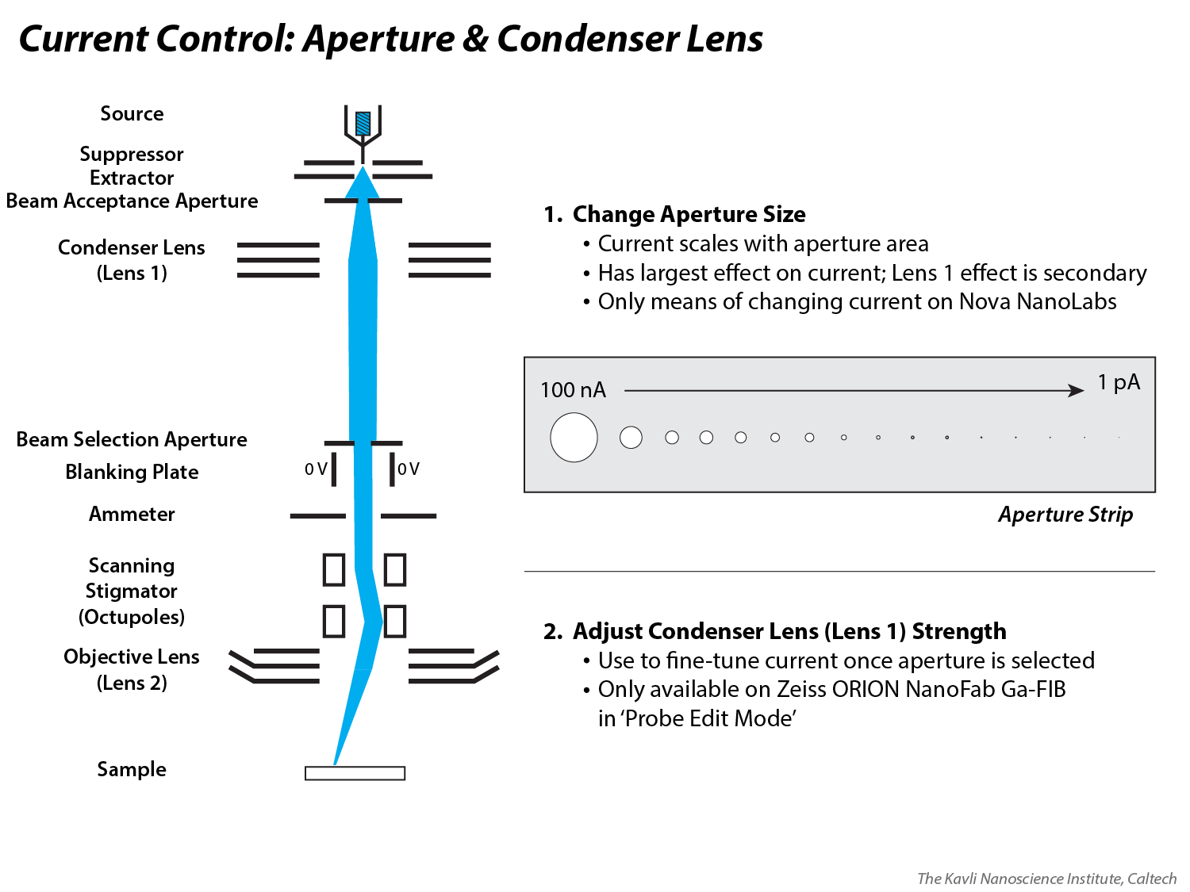
Notes:
The primary method of adjusting Ga-FIB current is by adjusting the size of the beam selection aperture. In the Thermo Fisher (formerly FEI) Nova NanoLabs, aperture selection is all that the user has access to for current adjustment.
On the Zeiss ORION NanoFab, a user can also make changes to the condenser lens (aka Lens 1) strength, in order to fine-tune the current that is incident on the sample. Different condenser lens settings are illustrated in the next slide.

Slide 29
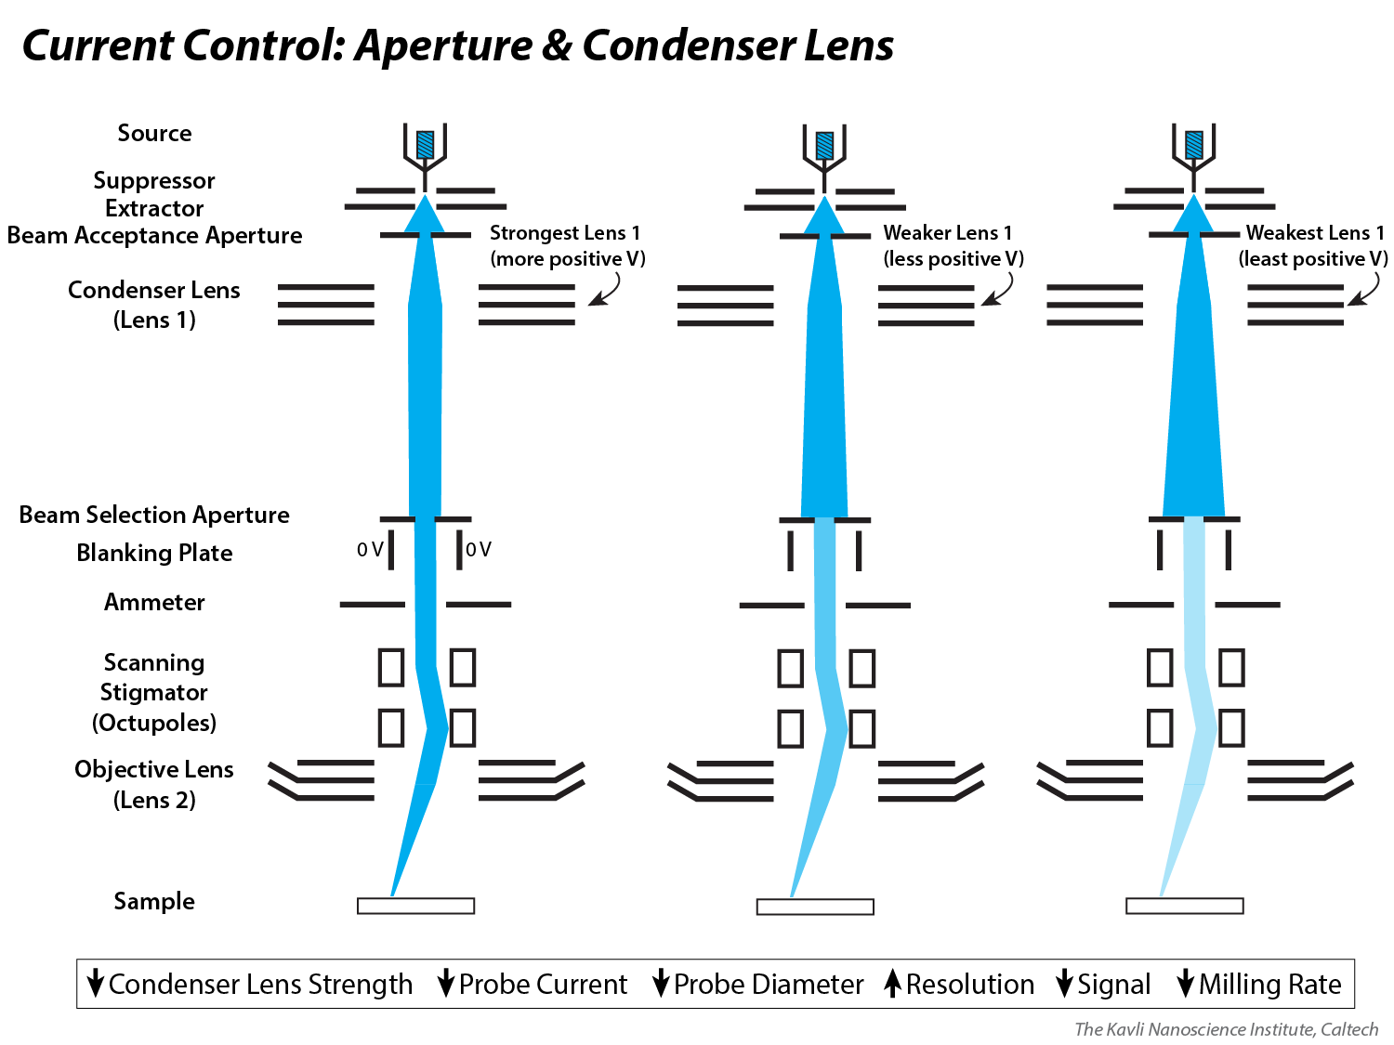
Notes:
This slide illustrates how changing the strength of the condenser lens (aka Lens 1) on a Ga-FIB can change the amount of current that passes through any given beam selection aperture. A stronger (aka more positive V) condenser lens will focus the beam more narrowly on the aperture, thus allowing more current to pass through. A weaker (aka less positive V) condenser lens will result in a more divergently focused beam at the aperture, thus allowing less current to pass through. The Lens 1 strength can be altered in “probe edit mode” on the ORION NanoFab as a way to create a beam with a current that is not prescribed by any one aperture, by default; that is, any arbitrary Ga-FIB current can be tuned on the ORION NanoFab by selecting an appropriate aperture size and modifying the condenser lens strength.

Slide 30
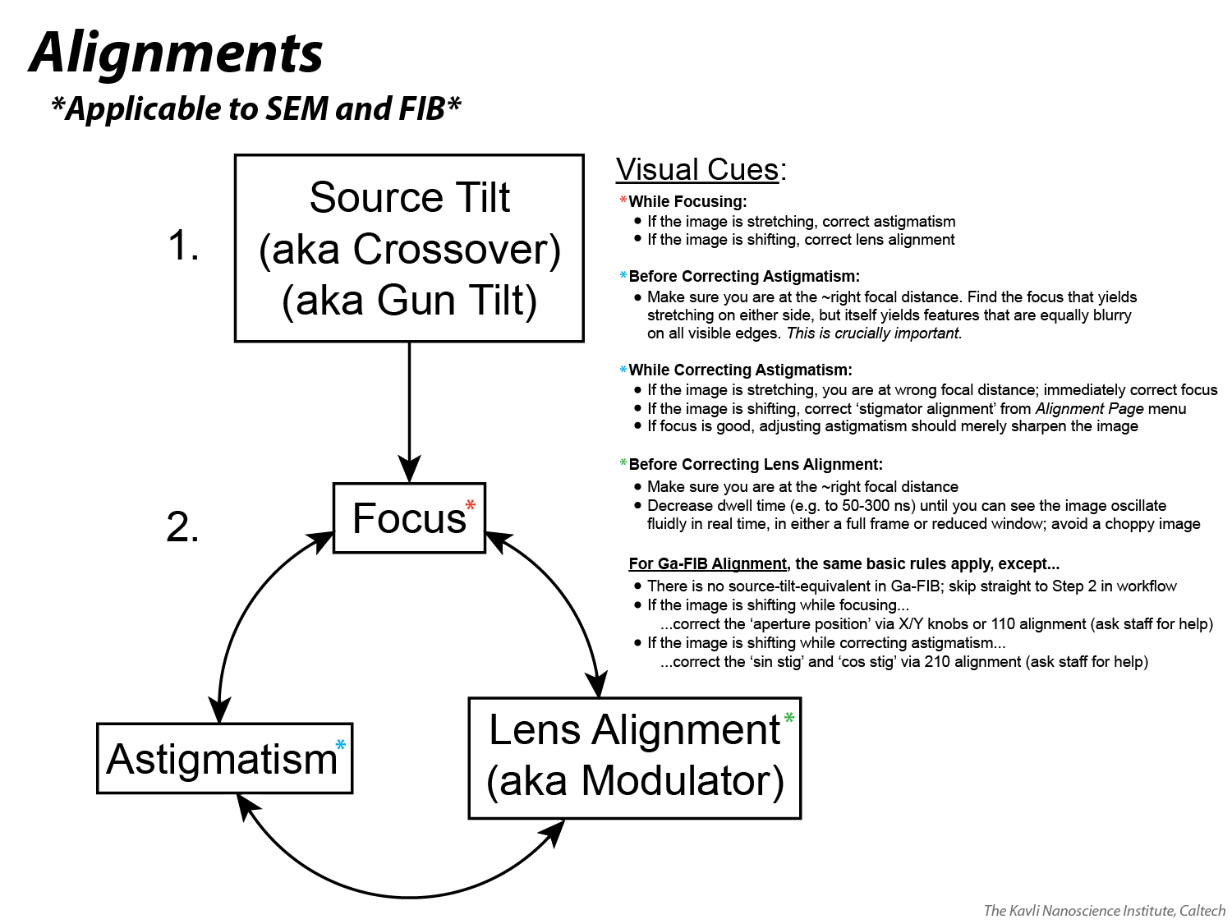
Video: https://youtu.be/luC-5TgNPsQ

Slide 31
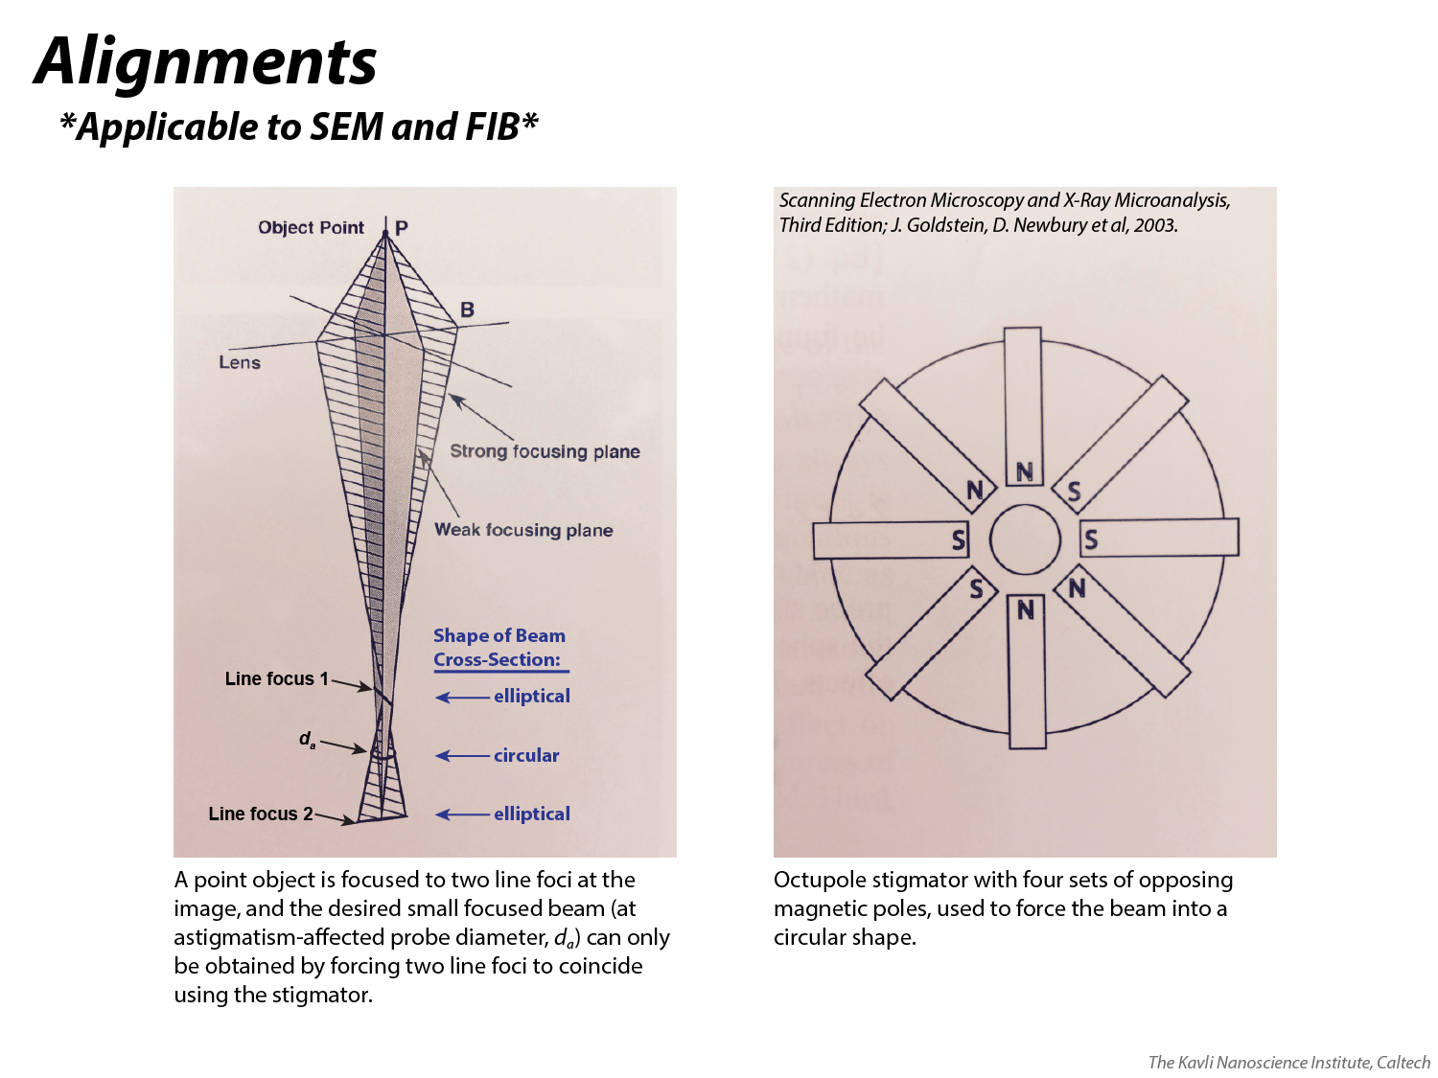

Slide 32


Slide 33
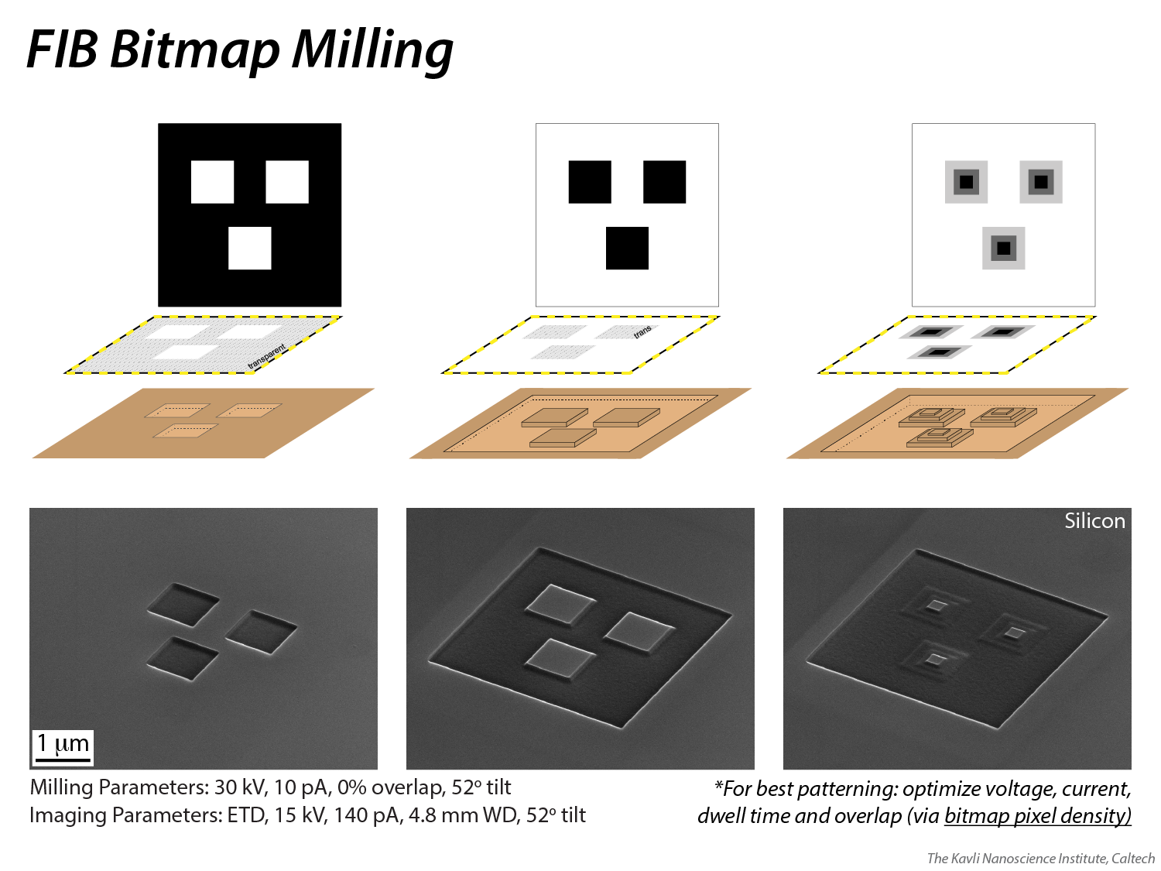
Notes:
Bitmaps offer a way to mill arbitrary 2D patterns. Reasonably good results can also be achieved milling 3D patterns by varying the grayscale value of bitmap pixels. For best bitmap milling results, optimize Z depth, voltage, current, dwell time, and X/Y pitch (by varying bmp pixel density vs. pattern size). The dwell time per pixel is proportional to the grayscale value: 0 (black) gets 0% of the dwell time, 255 (white) gets 100%, and e.g. 127 (middle gray) gets 50%.

Slide 34
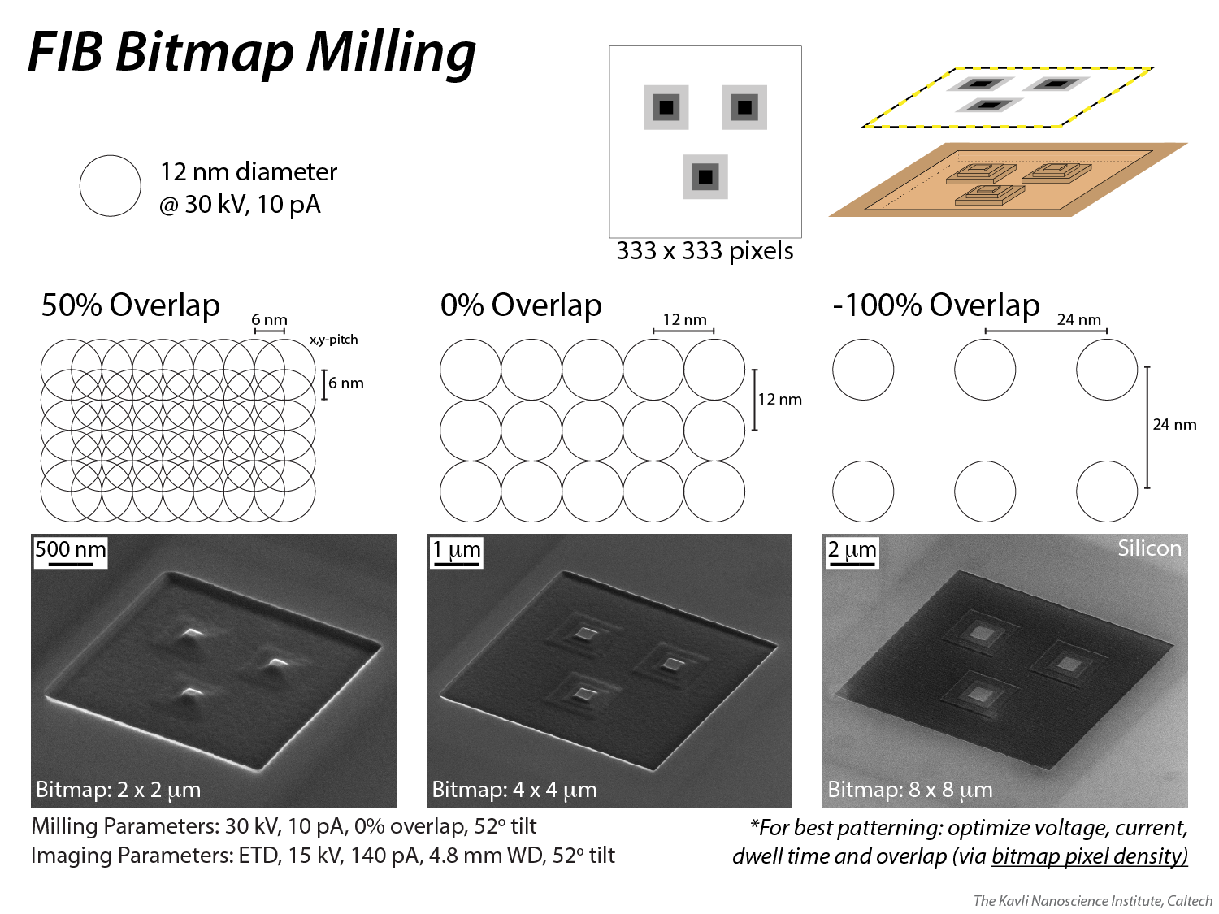
Notes:
Milling the same bitmap at three different length/width dimensions is a way to change the %overlap of the ion beam. Pattern quality will differ as a function of the %overlap, so from a practical standpoint it may be worthwhile to export a bitmap from your graphical software (e.g. Photoshop) at several different pixel densities, testing each to determine which %overlap produces the best result on your specimen material.

Slide 35
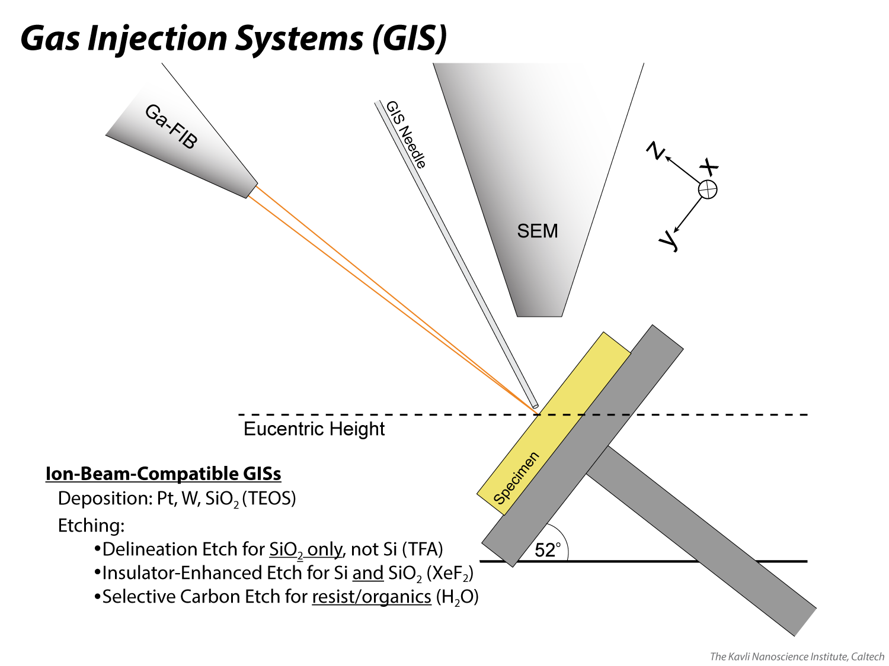
Notes:
Typically, the stage is oriented perpendicular to the beam that is being used with the GIS. So the stage is tilted to 52 degrees if the i-beam is being used, 0 degrees if the e-beam is being used (other tilt angles may result in desirable or undesirable deposition geometries). Either way, confirm that the stage is at eucentric height before inserting the needle; it will insert to a height that is approximately 100 microns above eucentric height so the operator risks crashing the needle into the specimen (touch alarm is triggered, needle is immediately retracted) if eucentric height is not accurately obtained. If you are too *far* away from eucentric height, the needle will insert safely but the gas concentration at the specimen surface may be less than ideal for the application.

Slide 36
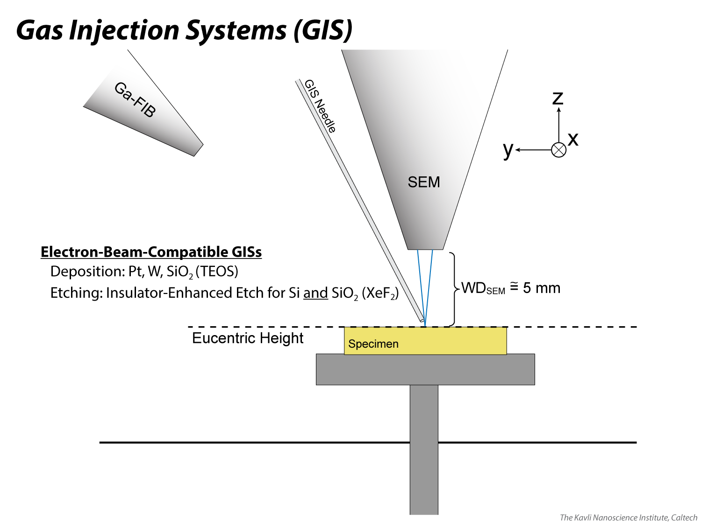
Notes:
Typically, the stage is oriented perpendicular to the beam that is being used with the GIS. So the stage is tilted to 52 degrees if the i-beam is being used, 0 degrees if the e-beam is being used (other tilt angles may result in desirable or undesirable deposition geometries). Either way, confirm that the stage is at eucentric height before inserting the needle; it will insert to a height that is approximately 100 microns above eucentric height so the operator risks crashing the needle into the specimen (touch alarm is triggered, needle is immediately retracted) if eucentric height is not accurately obtained. If you are too *far* away from eucentric height, the needle will insert safely but the gas concentration at the specimen surface may be less than ideal for the application.

Slide 37
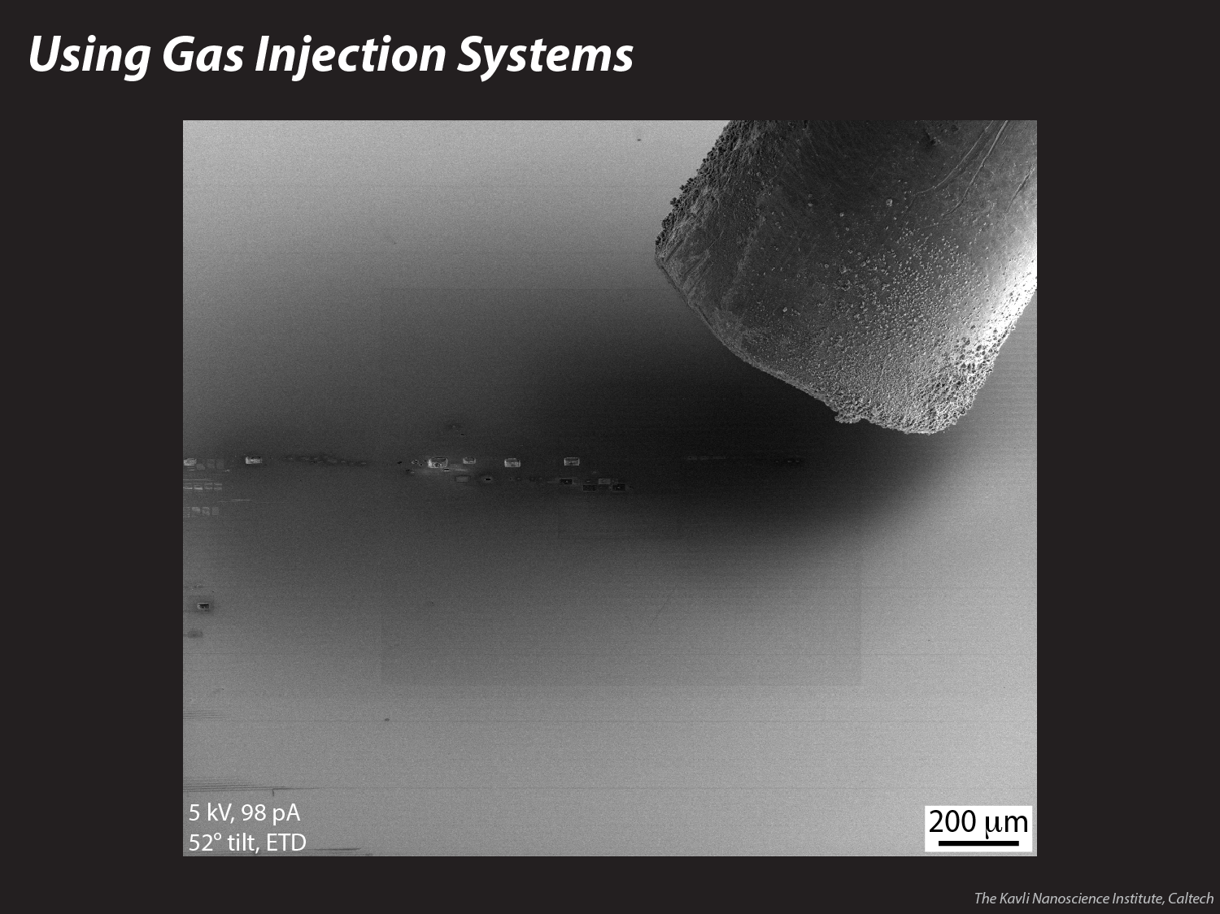
Notes:
An image demonstrating how close the needle inserts relative to the specimen surface when at eucentric height (~100 microns away). This is the IEE (XeF2) GIS probe and the stage is tilted here to 52 degrees.

Slide 38
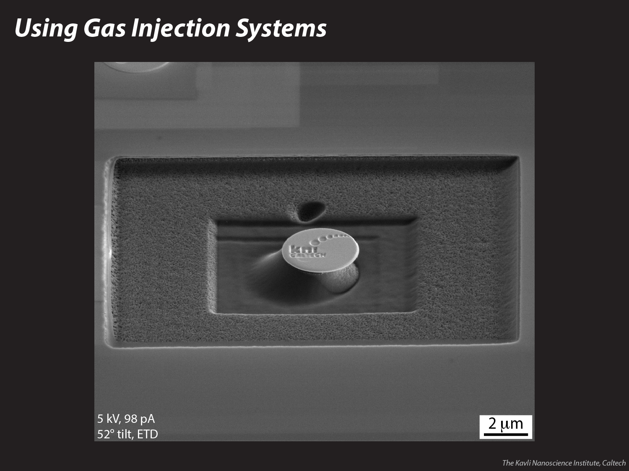
Notes:
There is some directional shadowing when using the XeF2 GIS to enhance an Si and/or SiO2 etch, as demonstrated here. The needle, as shown on the previous slide, inserts from the right, so the left side of this pillar is etching at a slower rate. This happens because the gas is more readily replenished on the side of the pillar that is facing the needle than on the side that is facing away from it. Thus the side facing away, with less gas present, will not experience the same enhanced etch rate. XeF2 can also be used to increase the aspect ratios of milled patterns (e.g. thin lines or small holes) because the gas reacts with the sputtered material, readily converting it to a vapor phase that can be pumped out of the system. Without XeF2, more of the sputtered material would be redeposited on the specimen, e.g. staying at the bottom of a deep hole and preventing further milling from occurring. Note that XeF2 may react adversely with some materials so it is not an option for all samples.

Slide 39
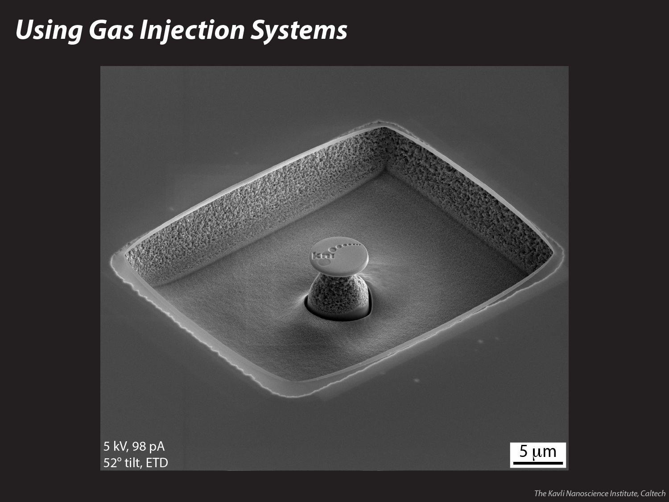
Notes:
A platinum disc on top of a XeF2-etched, Si pillar, with the (old) KNI logo milled into it using a variable grayscale bitmap.

Slide 40
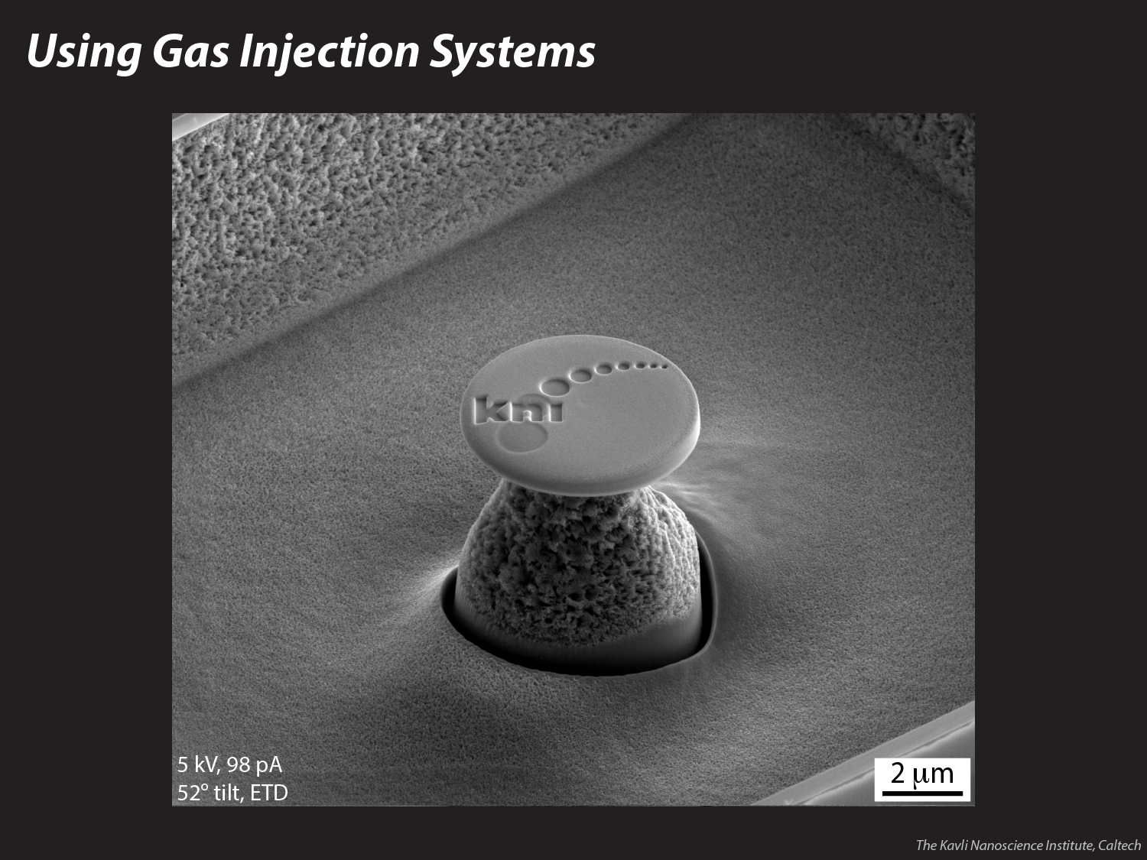
Notes:
A platinum disc on top of a XeF2-etched, Si pillar, with the (old) KNI logo milled into it using a variable grayscale bitmap.

Slide 41

Depositing Platinum Using the Focused Ion Beam https://youtu.be/N3TvkueNtu4
Patterning Complex Shapes with Bitmap Milling https://youtu.be/IwuUVDc5P2g
Enhanced, Site-Specific Si Etch with XeF₂ Gas and FIB https://youtu.be/9SYPKl2va5w
Improving FIB Alignments at Low Current
https://youtu.be/XNgYe8ZDJvo
Notes:
Find these videos on KNI’s YouTube channel.

Slide 42
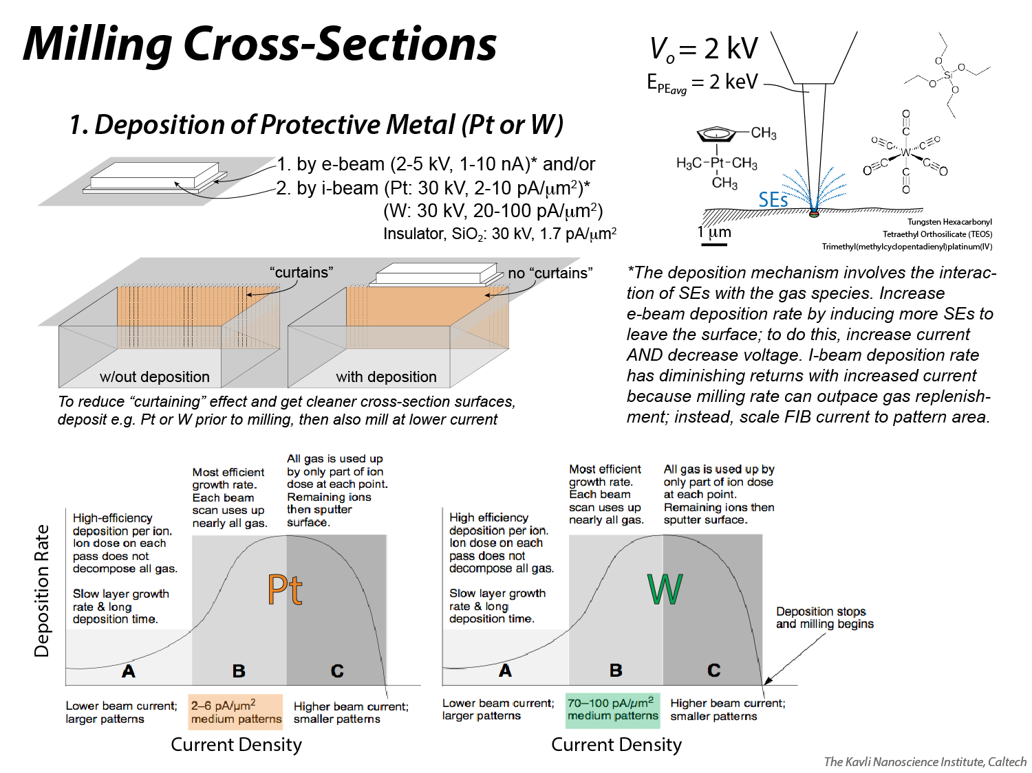
Notes:
Surface protection with deposited metal will result in a cleaner cross-section interface. For very large cross-sections that require high currents and/or long milling times, surface protection with a thin layer of e-beam-deposited metal, followed by a thicker layer of i-beam-deposited metal, is recommended to ensure the metal itself does not get sputtered away before the cross-section is complete (the e-beam-deposited layer should be thicker than the i-beam interaction volume to ensure that all Ga gets trapped in the e-beam-deposited metal, not in the specimen itself). For smaller cross-sections, the operator may find that setting up only the e-beam deposition step – and simply letting it run for a longer period of time – may be more efficient than setting up two separate depositions. If you are executing a rectangular-shaped e-beam deposition, try scanning in a live reduced window (rather than defining an e-beam pattern on the Patterning Page) so you can watch the deposition live with the SE signal that is produced from the scan; beam shift to compensate for any drift. Video tutorials for depositing metal, cutting cross-sections and imaging cross-sections are available on KNI’s YouTube channel (https://www.youtube.com/watch?v=VsDPqS3rWcQ&list=PL7Lb5X_YIzOnW6dD0GHeasXS6MRVIgoTA).
When depositing Pt or W with the i-beam, it is important to tune the beam current to get the appropriate current density on the patterned area. Note that the requisite i-beam current for Pt deposition is an order of magnitude less than that for W.

Slide 43
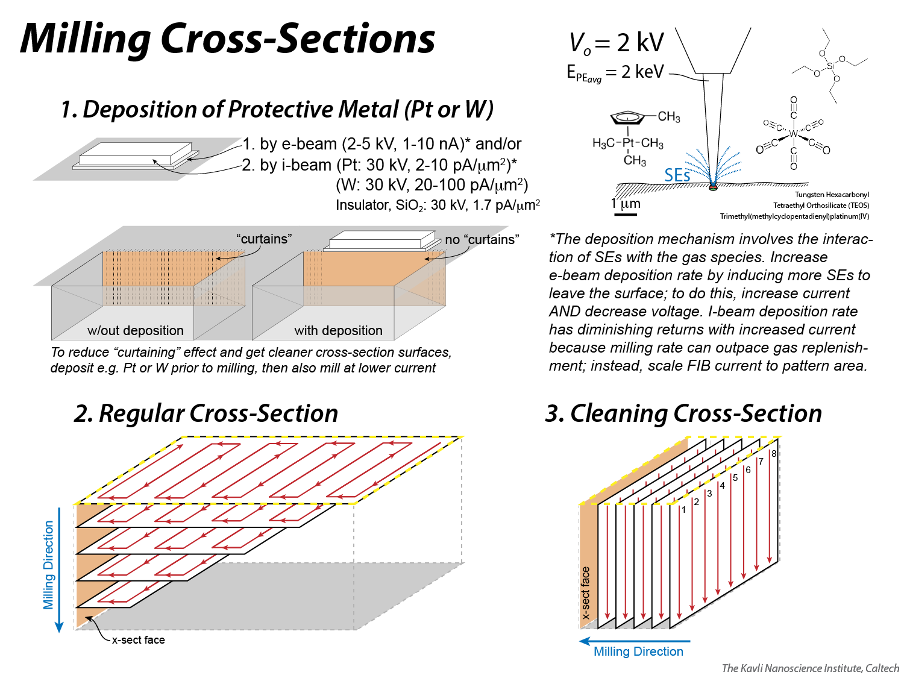
Notes:
Cross-sections are typically milled in two steps: (1) a “regular cross section” removes material from in front of the intended, final cross-section plane, and (2) a “cleaning cross section” is used to get a final, well-polished surface. In the diagrams, note the differences in the way the two different pattern styles are milled. The regular cross-section mills like any standard rectangle or circle, i.e. pass after pass, etching progressively down into the sample, only in this case, the size of the rectangle shrinks as a function of depth. The cleaning cross-section mills by having the i-beam effectively boring down at one beam position until it reaches what is expected to be the intended, final depth, before proceeding to the next beam position; because cleaning cross-section operate this way, it is important not to over-estimate the depth because it will result in a lot of wasted time.

Slide 44
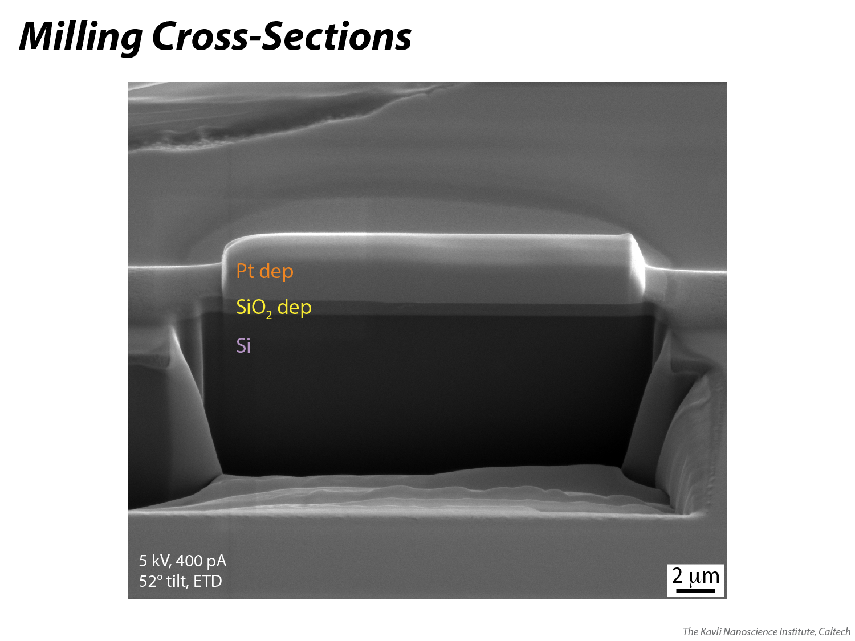
Notes:
An example of a large cross section, showing the trench slope defined by the regular cross-section and the smooth interface following the cleaning cross-section (the smoothness is helped by surface protection with platinum). Video tutorials for depositing metal, cutting cross-sections and imaging cross-sections are available on KNI’s YouTube channel (https://www.youtube.com/watch?v=VsDPqS3rWcQ&list=PL7Lb5X_YIzOnW6dD0GHeasXS6MRVIgoTA).

Slide 45
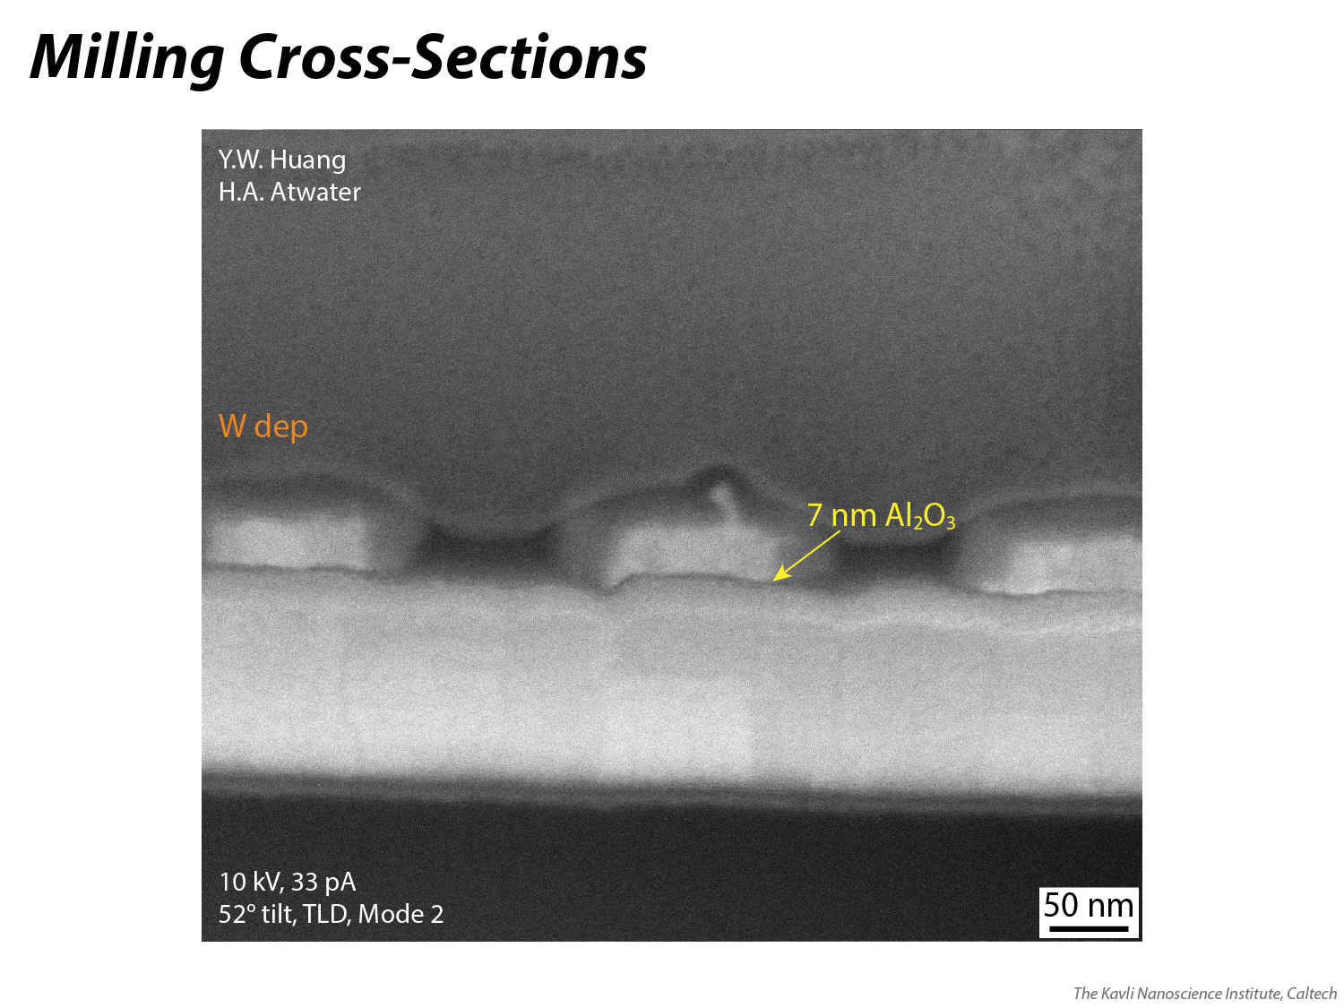
Notes:
In order to get high resolution, nanometer-scale resolution on a cross-section, e-beam-deposited tungsten was used to protect the surface of this device, and the final cleaning cross-section was milled with a 30 kV, 10 pA ion beam (~12 nm beam diameter). Following milling, several different e-beam imaging conditions were tested, ultimately settling on 10 kV, 33 pA in the high resolution, Immersion Mode (aka Mode 2). An “alignment rectangle” technique was used to perfect both the FIB alignment for cutting the cross-section and the SEM alignment for capturing the image. When you can see the nanoscale texture of the W (or Pt) grains, you can be sure that you have a good alignment to the cross-section plane. Video tutorials for depositing metal, cutting cross-sections and imaging cross-sections are available on KNI’s YouTube channel (https://www.youtube.com/watch?v=VsDPqS3rWcQ&list=PL7Lb5X_YIzOnW6dD0GHeasXS6MRVIgoTA).

Slide 46
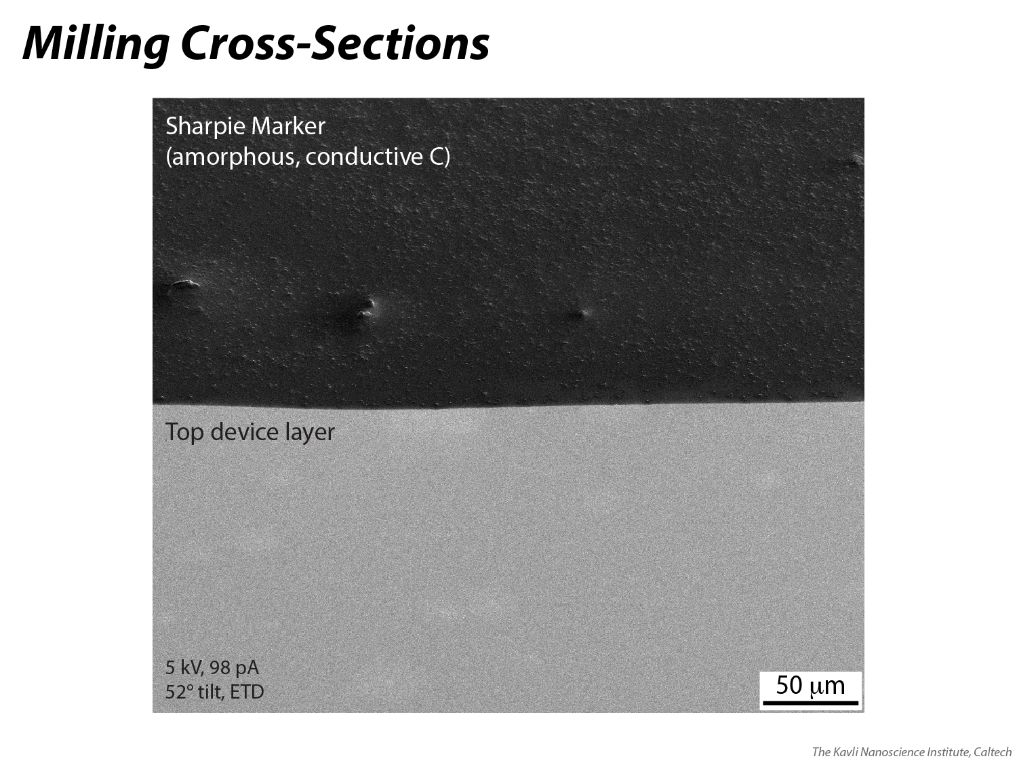
Notes:
Instead of spending time depositing site-specific metal to protect a surface before cross-sectioning, a Sharpie marker also works well to protect the surface; it puts down about 400 nm of amorphous carbon. Be sure to let the marker dry completely before putting it into the chamber and pumping. This technique works best when a site-specific cross-section is not needed, but rather a cross-section is needed anywhere on a homogenous surface.

Slide 47
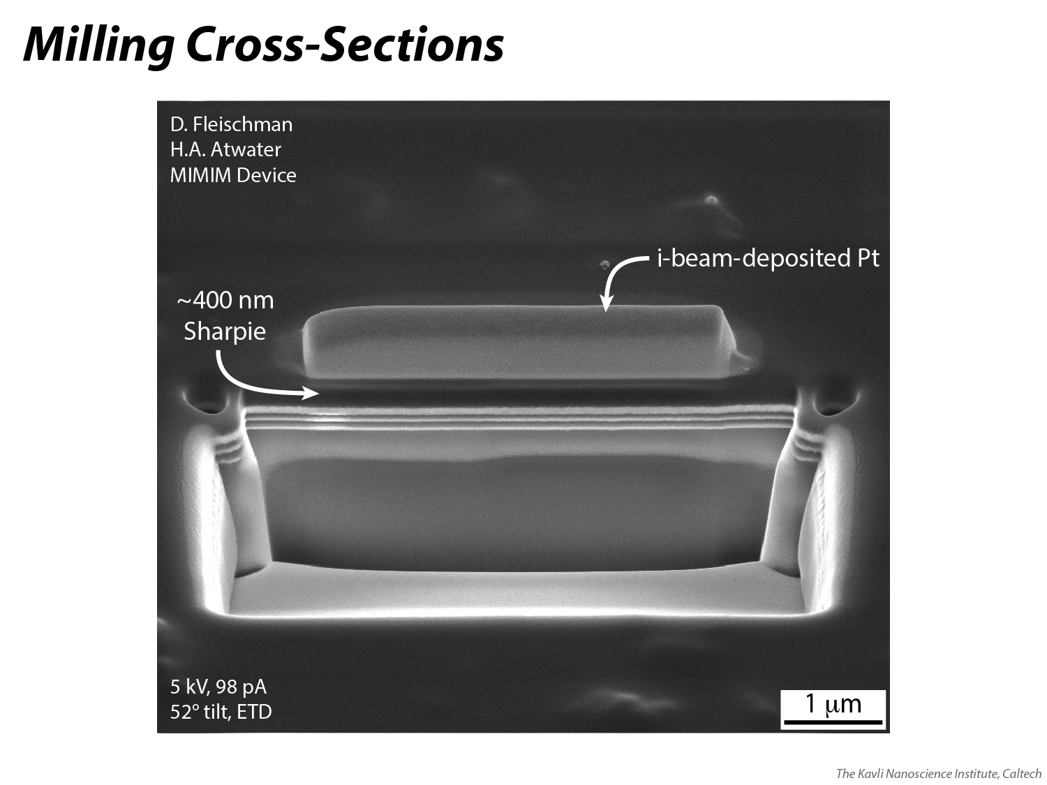
Notes:
In this case, a layer of i-beam-deposited Pt was put on top of the Sharpie (amorphous C) layer before cross-sectioning. Good cross-section results may also be achieved by cutting directly through the Sharpie layer, with no Pt deposited on top; results may vary according to the material composition and cross-section depth.

Slide 48
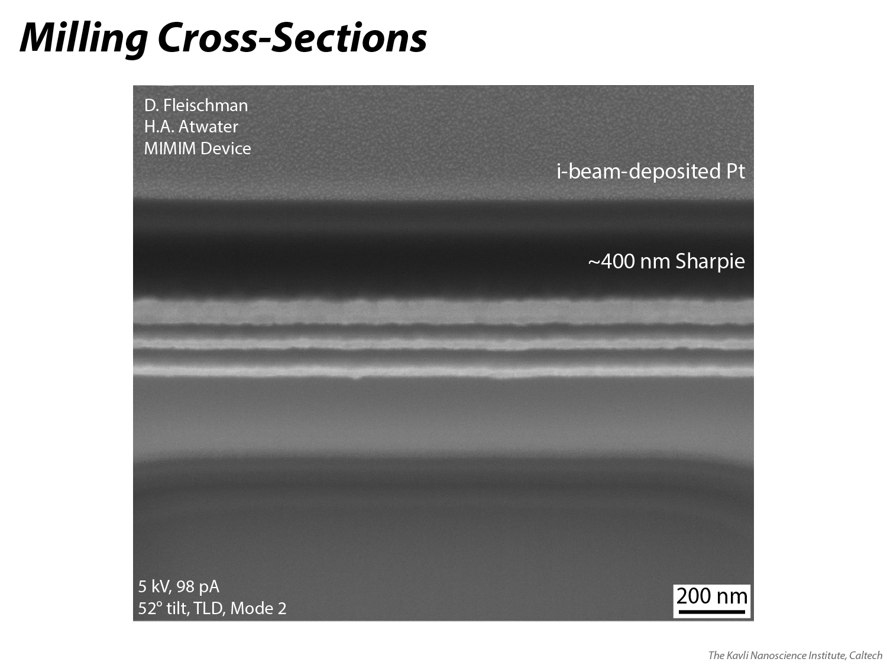
Notes:
High magnification image of the cross-section shown on the previous slide. For TEM sample preparation, it may be preferable to have an amorphous layer (like this Sharpie layer) directly above the top device layer. This may minimize the amount of Pt that is re-deposited onto the cross-section surface during the lamella thinning process.

Slide 49

Full Playlist https://www.youtube.com/playlist?list=PL7Lb5X_YIzOnW6dD0GHeasXS6MRVIgoTA
Depositing Platinum Using the Electron Beam
https://youtu.be/VsDPqS3rWcQ
Cutting a Site-Specific Cross-Section with FIB
https://youtu.be/hCGsudXj1Xc
Imaging a Cross-Section (1 of 3): First Approximation SEM Alignment in Immersion Mode https://youtu.be/tLuvURsBdWk
Imaging a Cross-Section (2 of 3): Fine-Tuning SEM Alignment with Alignment Rectangle https://youtu.be/sVNFJvZPGIo
Imaging a Cross-Section (3 of 3): Capturing the Final Image, Evaluating for Artifacts https://youtu.be/SXcoVGmlXws
Notes:
Video tutorials for depositing metal, cutting cross-sections and imaging cross-sections are available on KNI’s YouTube channel.

Slide 50
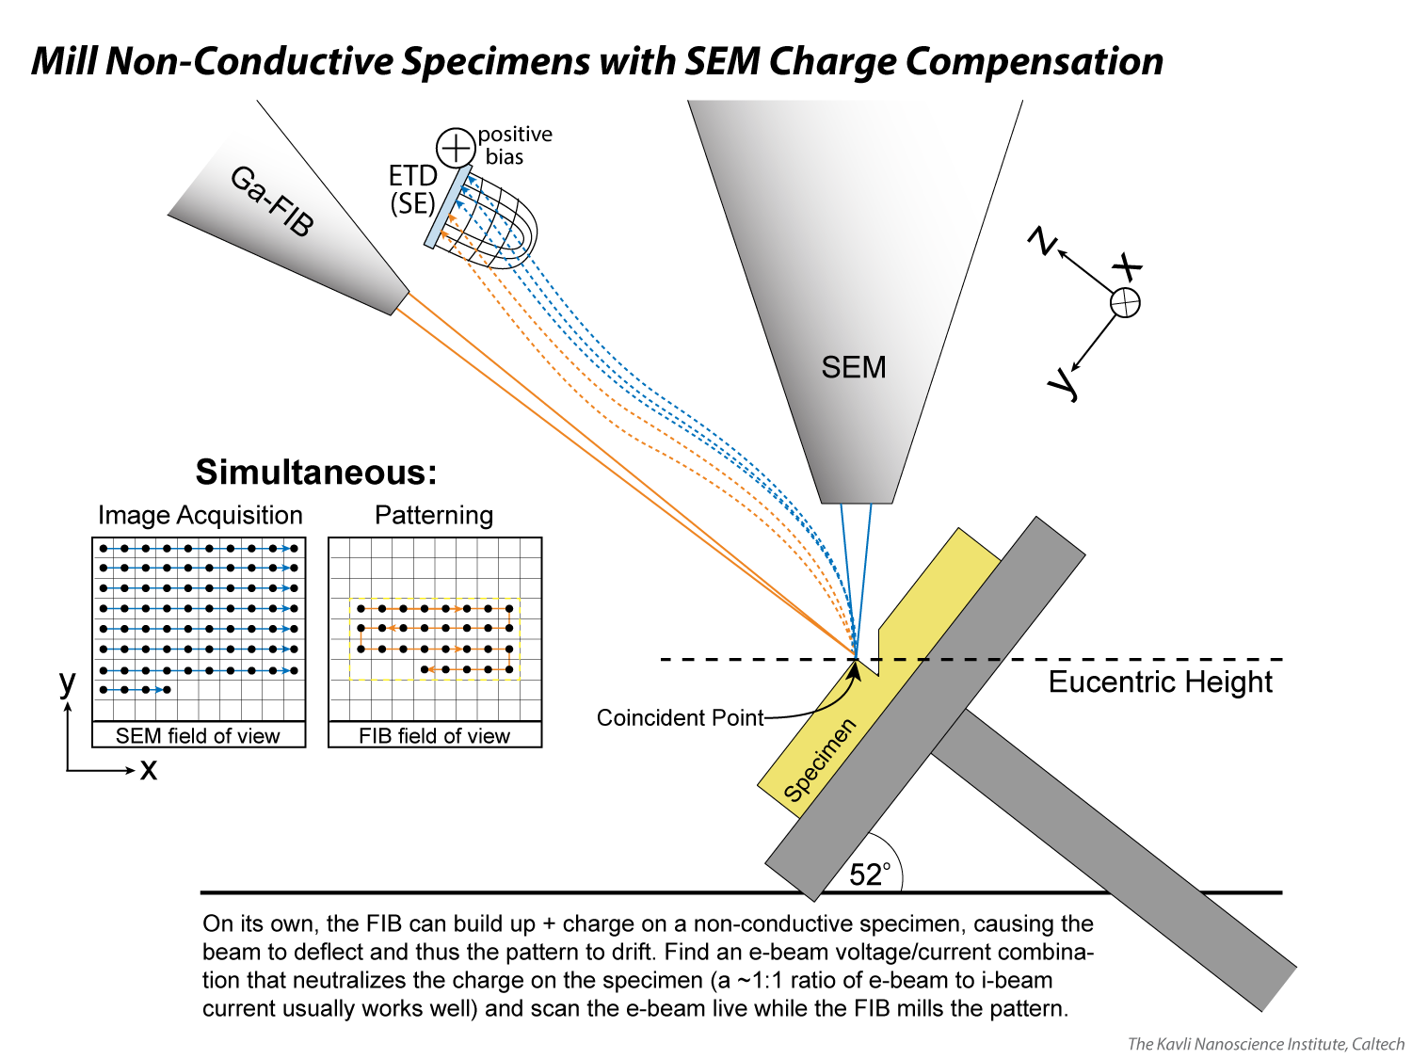
Notes:
See note on slide.

Slide 51

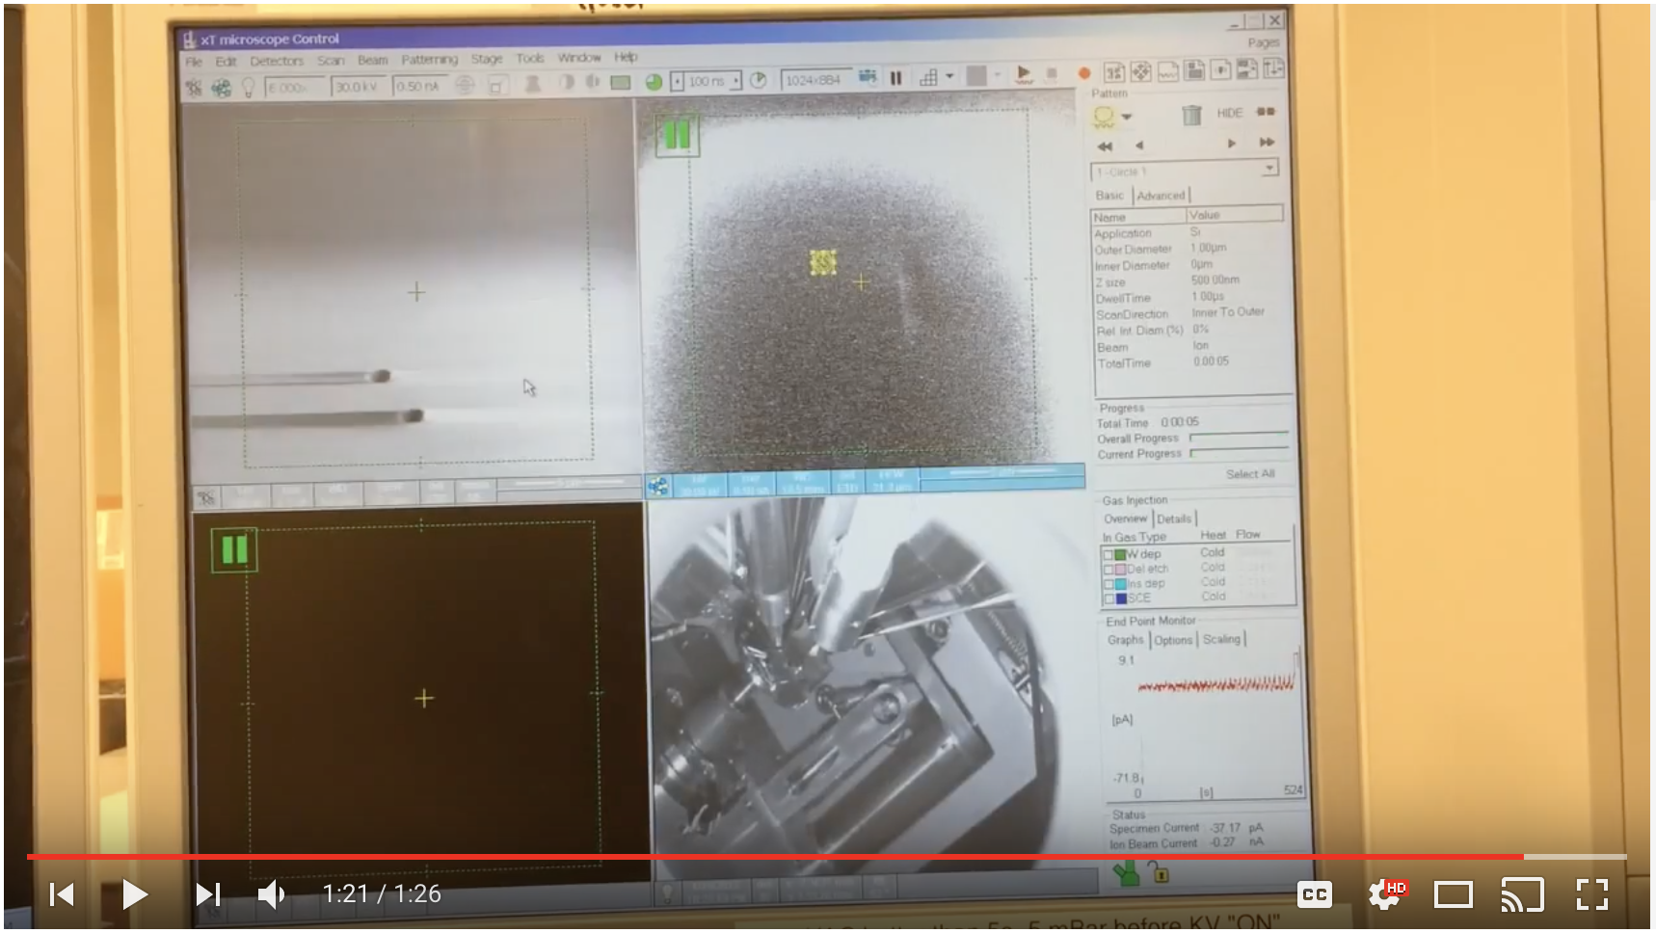
Using SEM/FIB Charge Neutralization to Mill Non-Conductive Specimens https://youtu.be/67RdSeJcaGs
Notes:
This video is a brief tutorial on how to use the electron beam to offset the positive charge of the ion beam during milling, which may allow you to mill on a non-conductive specimen.

Slide 52
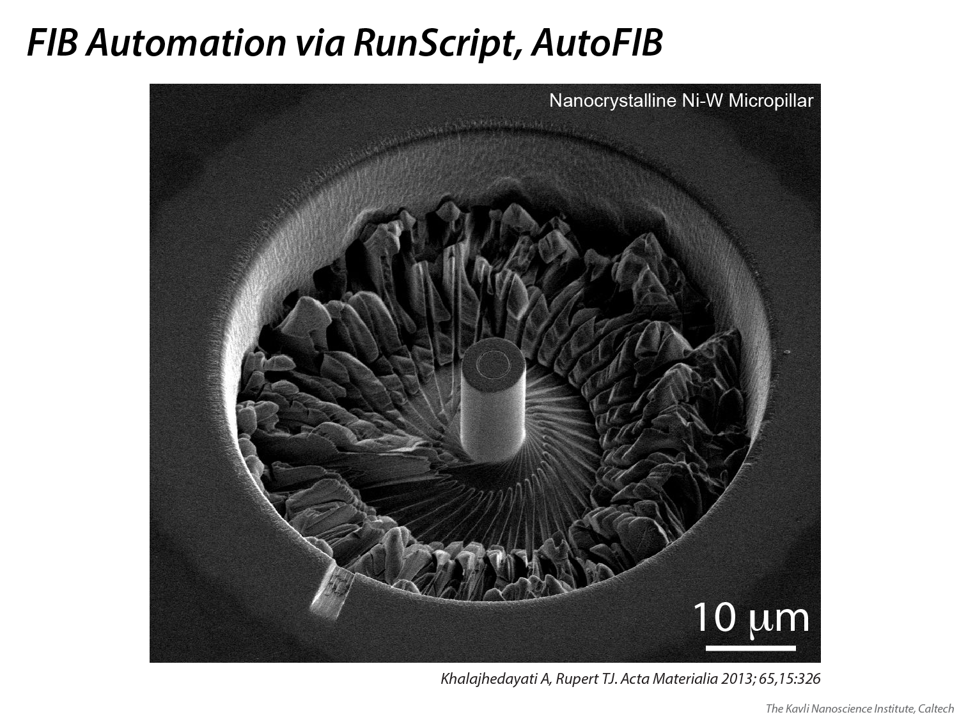
Notes:
RunScript.exe is an application that allows for the SEM and/or FIB to be automated according to a script. The scripting language, Thermo Fisher’s (formerly FEI’s) own ‘AutoScript,’ incorporates image recognition software that can, for instance, use a fiducial mark – like the circle at the center of this pillar – to shift the image into a predetermined location on the screen. This ensures the placement accuracy of each successive pattern.

Slide 53
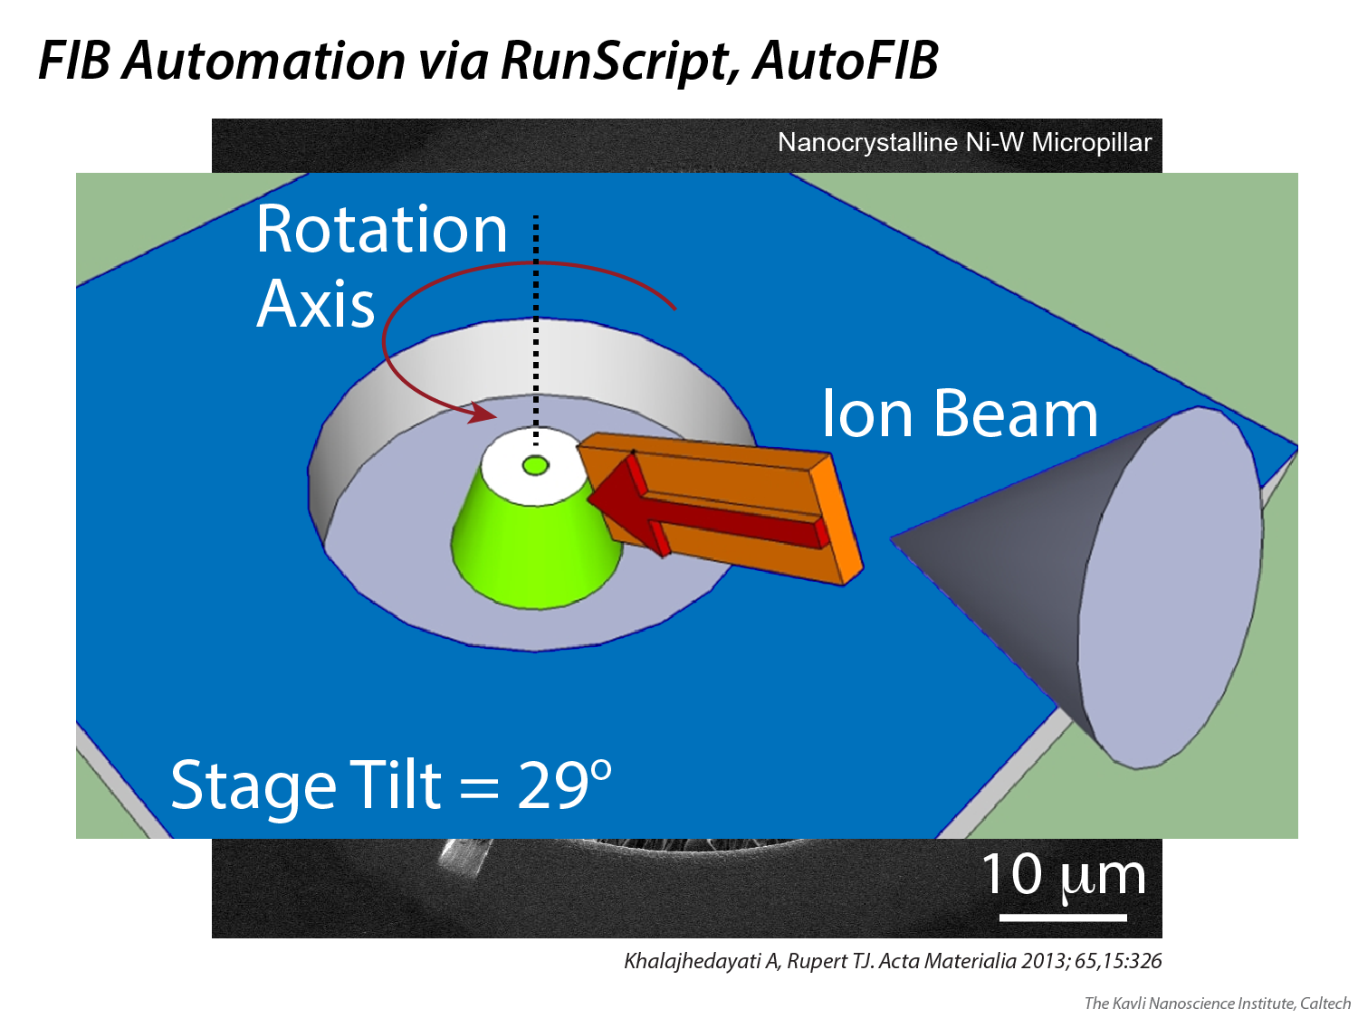
Notes:
In this case, a cleaning cross-section is used to cut tangential to the pillar, followed by a stage rotation, alignment of the circular fiducial mark to the center of the screen, the start of the next cleaning cross-section, etc.

Slide 54
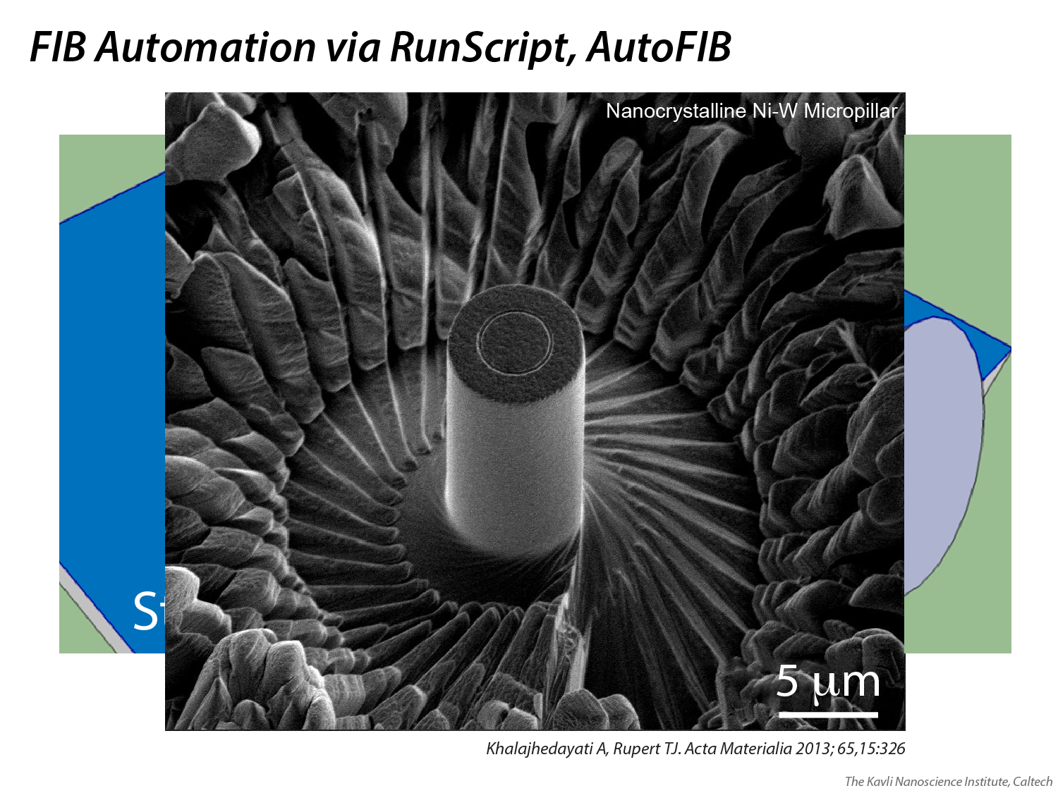
Notes:
The final result shows a spiral pattern around the pillar, resulting from ~35 cleaning cross-sections. The total automated milling time per pillar in this project was several hours.

Slide 55
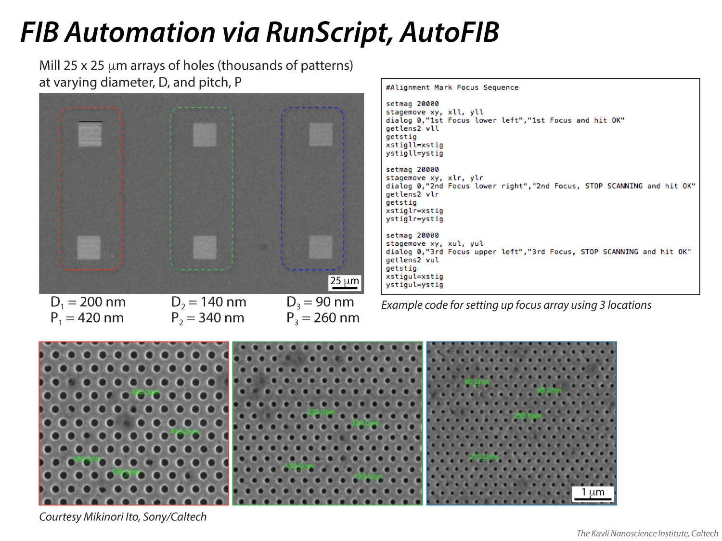
Notes:
This is an example of a custom script that was used to write thousands of small circles of varying diameters with variable pitches. In this case, the example code shows part of the sequence whereby three locations are used to establish a focal array for the entire work area (i.e. the focal distance for any given location can be interpolated from the three values obtained around the perimeter of the area). Thermo Fisher (formerly FEI) has its own simple scripting language, AutoScript, that can be used to automate projects such as this.

Slide 56

Notes:
An Thermo Fisher (formerly FEI) program, Auto Slice and View, automates the ion beam to cut a cleaning cross-section (slice) and then image the result (view), repeating the process as many as hundreds of times to produce an image stack. The imaging parameters set the x and y dimensions of the resulting voxel; the slice thickness sets the voxel’s z dimension. With proper planning, the operator can capture cubic voxels, which make for easier manipulation and interpretation of the final data cube.

Slide 57

Notes:
The image stack (captured here with a BSE detector and then thresholded using MATLAB) is then aligned, cropped and recombined in another software program (e.g. Thermo Fisher/FEI’s Amira or Avizo) to produce a 3D model of the material. This allows for any number of calculations to be made on the microstructure, having been rendered into voxels.

Slide 58


Slice & View Movie (aligned)
https://youtu.be/Ftdofi3nv08
Notes:
This is a video reconstruction of several hundred frames that were captured over the course of ~8 hours using a backscatter electron detector to show material phase contrast. The slices were aligned and put together using the software program, Amira.

Slide 59

Notes:
The Omniprobe is a tungsten probe that can be controlled with a precision on the order of 10s of nanometers. It is most often used to extract thin lamella samples that are then observed in e.g. a transmission electron microscope (TEM, Slides 66-67), but it can also be used as an electrical prober, if properly configured, or to do a number of other pick-up-and-drop tasks. In the KNI, the probe, which is purchased with a tip radius of curvature around 1 micron and a diameter that quickly expands to several and eventually 10s of microns, is often sharpened such that that the tip is formed into a rectangular prism measuring roughly 1 micron x 1 micron x 20 microns long (see inset image); this sharpening is done in situ with the Ga-FIB.

Slide 60

Notes:
The Omniprobe, in this case, has been welded to a thin lamella specimen that was prepared with Ga-FIB. The weld was made with Pt. The final piece of material connecting the lamella to the bulk specimen is now ready to be cut (left side), thus completely freeing the lamella. Note that while in an SEM view, the Omniprobe comes in from the left side of the window; often times when using the Omniprobe with the Ga-FIB, the image is scan-rotated 180 degrees such that the probe comes in from the right of the Ga-FIB window, as seen in Slides 61-65. [Without the scan rotation, if the stage is tilted to 0 degrees, the probe enters the FIB window from the left, owing to the geometry between the stage, probe and Ga-FIB angle.]

Slide 61


Omniprobe Lift-Out of Thin Foil for TEM Analysis https://youtu.be/UlhD3mVSw_c
Notes:
This video shows a thin lamella (aka foil) being lifted out by the Omniprobe. After lift-out, the lamella will be welded onto a TEM grid and thinned to a final thickness that is suitable for the required TEM analysis.

Slide 62

Notes:
The foil can be directed over to e.g. a TEM grid, to which it is welded with Pt (on the left side of the lamella here). Once attached to the grid, the probe can be cut (yellow pattern outline) to release it from the lamella.

Slide 63

Notes:
Here the lamella can be seen attached to the grid, with the Omniprobe retracting away from it. The Pt GIS is shown hovering above, at top-left.

Slide 64

Notes:
One common way of attaching a lamella to a TEM grid is shown at top. The benefit of attaching to the side of the grid is that you can attempt to thin half of the sample (as shown) and, if you make a mistake, you can try again on the other half without any problem. The drawback of this method is that for softer materials, the lamella can start to bend and twist as it gets to be very thin, which can be detrimental to many TEM analyses.
To combat bending and twisting, the lamella can be attached to the top of a grid post, welding it with two points of contact. Here you can see that a notch was first cut out of the grid post with the FIB so that later during the thinning process, no Cu (from the grid) would be re-deposited onto the sample. In addition to providing mechanical stability to the lamella, this orientation is preferable for EDS analysis in the TEM, in general. Instead of cutting a notch, users may also purchase TEM grids with “V” notches that accommodate two-point welding of a wide range of widths, without the need for the user to custom cut a notch; Cu redepositon with “V” notches may be worse than with a custom cut notch.

Slide 65

Notes:
Cross-sections are the most common type of lamella prepared for TEM analysis, but surface sections are also possible to lift out and thin. The two procedures are similar in scope but vary in terms of the geometry of the cuts that must be made. Inquire with KNI staff to learn how to create either type of lamella.

Slide 66

Notes:
An overview of the techniques, specifications and configuration for the Thermo Fisher (formerly FEI) Tecnai TF-30 TEM in the KNI (not located in the cleanroom, but rather in the Keck building on campus).

Slide 67

Notes:
An overview of the techniques, specifications and configuration for the Thermo Fisher (formerly FEI) Tecnai TF-20 TEM in the KNI (located in the cleanroom).

Slide 68

Notes:
Some examples of TEM work done in KNI. At top left are quantum dots imaged in high resolution (HRES) mode to visualize their atomic structure and measure their diameter (~5 nm). At top right is a bright field image of alternating ~100 nm layers of metal and insulator, showing the nature and orientation of grain boundaries present in the metal layers. At bottom left is a bright field image of a layered device grown with molecular beam epitaxy, showing layers as thin as 1-2 nm. At bottom right is an electron diffraction study that was used to evaluate the orientation mismatch of the top silicon layer of a device to the underlying silicon substrate.

Slide 69

Notes:
In December 2016, the KNI obtained a Zeiss ORION NanoFab, a He/Ne/Ga-FIB microscope. Ne and He ions, significantly and progressively less massive than Ga ions, can be to perform more small scale milling than is possible with Ga. Some examples are included on this slide, along with a SRIM simulation of Ga vs. He ion sputtering (bird’s eye view). See a separate KNI presentation for full details on the ORION NanoFab; that presentation will be located in the same folder from which you downloaded this presentation.

Slide 70

Notes:
Examples of He, Ne and Ga FIB microscopy using the Zeiss ORION NanoFab.

Slide 71

Notes:
During imaging, the local specimen area will heat up due to added energy from the beam. If there is organic matter on the surface from a previous process (e.g. solvent treatment) or from simply being exposed to the ambient environment, the heat causes hydrocarbons to evolve from the surface, whereupon they become a precursor gas for an e-beam-aided, chemical-vapor-deposition of carbon back onto the surface, now in a denser form. This carburization of the surface often results in a “black box” appearing in areas where the beam was highly concentrated, e.g. where a reduced area window was used for a focusing step (carbon has a low yield of secondary electrons and thus the carbon area appears darker). Note that the carburization process happens more quickly at lower e-beam accelerating voltages because the chemical vapor deposition is dependent on the presence of SEs, which are emitted in higher quantities at low voltage. Cleaning a specimen with an O2 and/or Ar plasma (or H2 if a reducing environment is necessary to prevent oxidation) will remove the hydrocarbons and prevent this process from happening to a noticeable degree.
For non-conductive specimens that cannot be effectively imaged with some combination of low kV, low current, zero detector bias and scanning filters, depositing a thin, conductive layer of carbon on the surface can help. This Leica carbon evaporator produces amorphous, conductive films, the morphology of which is not detectable in an SEM image. After imaging is complete, the carbon can be gently removed with an O2 plasma using the cleaner shown on this slide.

Slide 72


Notes:
A more detailed description of the Tergeo Plus plasma cleaner. Sample runs can be configured according to the wide range of options outlined on the slide. Cleaning runs can run from seconds to minutes to even hours, if necessary.

Slide 73

Notes:
Handout used to teach Ga-FIB concepts during training.

Slide 74

Notes:
Handout used to teach He,Ne-FIB concepts during training.

Slide 75

Notes:
Handout used to teach SEM concepts during training.

Slide 76

Notes:
Handout summarizing the workflow and visual cues associated with performing an SEM or FIB alignment. Properly correcting astigmatism is pivotal to obtaining a good alignment/image; a breakdown of the visual cues associated with it are provided along with a physical description of how those cues originate (more descriptive slides/videos of this are shown in this presentation). Astigmatism correction is particularly vital to a good alignment/image, so it is described in detail here.

